Slide 1
Keynote Address:
Transformational Technologies in Healthcare – All Aboard!
John D. Halamka, MD
#Conv2X
October 24, 2018
Lerner Hall Columbia University, NYC, USA

Slide 2
Deep Learning on Big Data

Slide 4
The Internet of Things

Slide 5
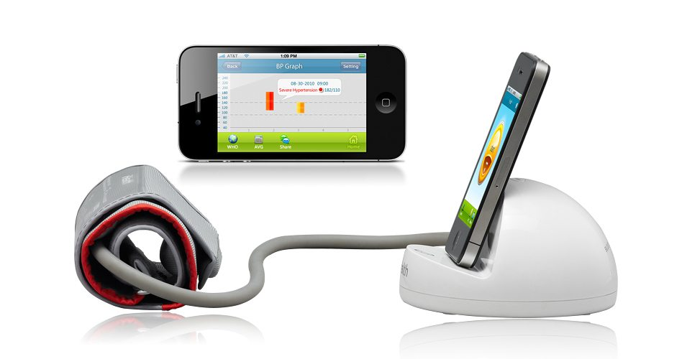

Slide 6
Ambient Listening and Geolocation

Slide 7
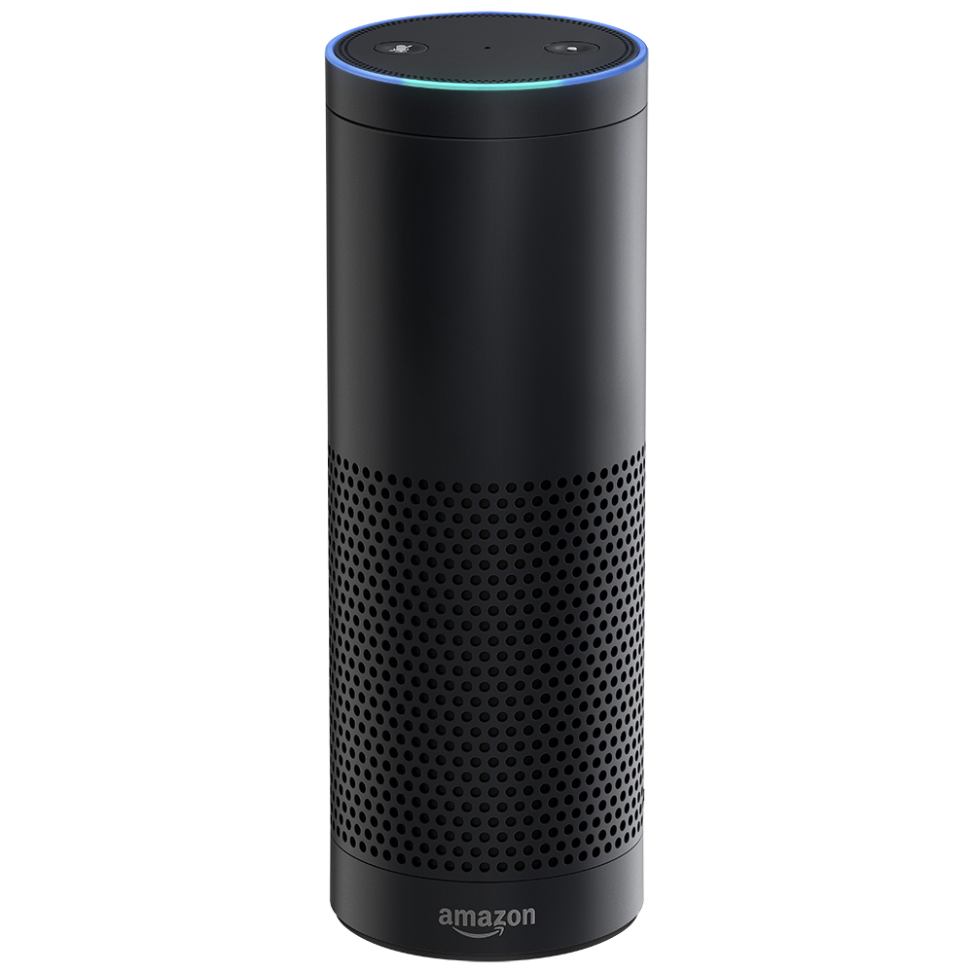

Slide 8
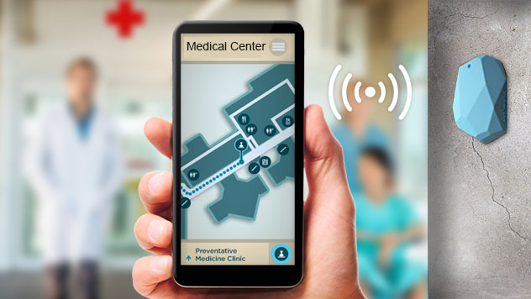

Slide 9
Cloud and Blockchain

Slide 10
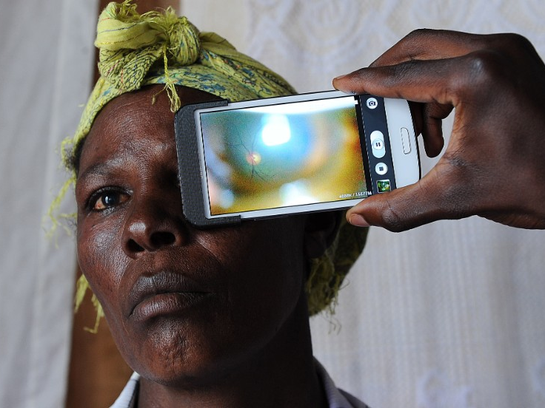

Slide 11
Mobile, Apps, and Telecare

Slide 12
