Slide 1
MUSC National Beacon of Telehealth Excellence: Case Use for Future Development
Kathryn King Cristaldi, MD
Dee Ford
James McElligott
#Conv2X
October 24, 2018
Lerner Hall Columbia University, NYC, USA

Slide 2
Telehealth Center of Excellence: Case Use for Future Deployment
Dee W. Ford, MD; Katie Cristaldi, MD; Jimmy McElligott, MD

Slide 3
Why MUSC is a Telehealth Center of Excellence
Telehealth expertise
Financially sustainable models
Service to rural and underserved communities

Slide 4
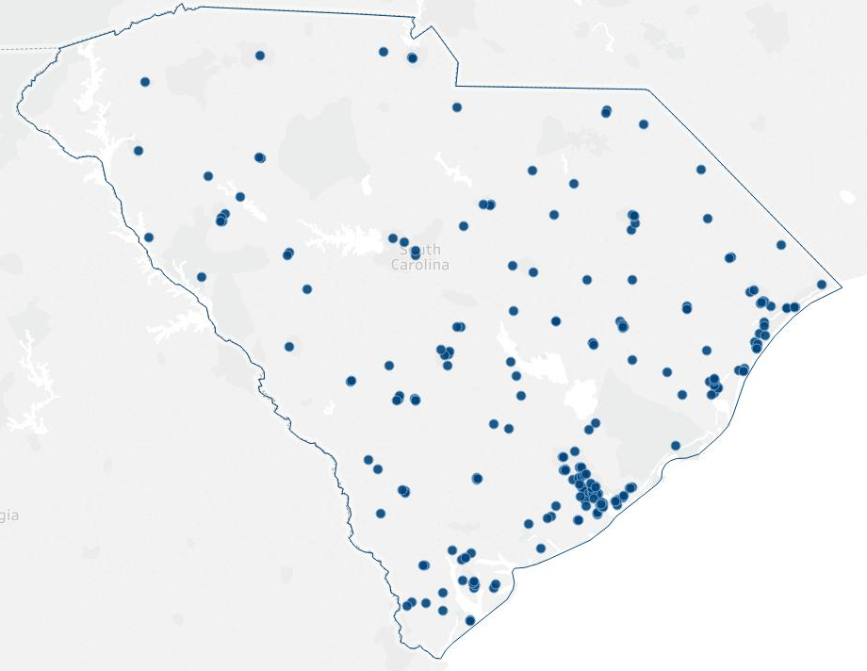
Telehealth Expertise
“Successful telehealth program with breadth, depth, and high volume”
77 unique services; 275 sites; 40 SC counties
40 hospitals; 126 community clinics; 92 other sites including 80 schools
. = MUSC Telehealth site
https://www.hrsa.gov/ruralhealth/programopportunities/fundingopportunities

Slide 5
Financial Sustainability
“Financially self-sustaining reimbursement structure(s)”
Current financial models:
Direct negotiation with payers
Supply-demand model with participation fee
Sustainability through scale and volume
Corporate partnerships
https://www.hrsa.gov/ruralhealth/programopportunities/fundingopportunities

Slide 6
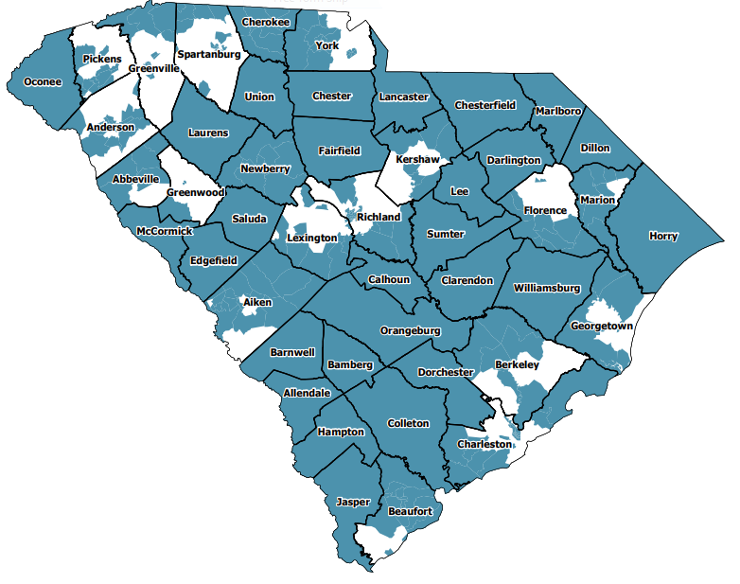
Service to Underserved Areas
Blue = fully or partially medically underserved
“Telehealth services to medically underserved areas with high prevalence of chronic disease”
78% of services in completely or partially medically underserved regions
https://www.hrsa.gov/ruralhealth/programopportunities/fundingopportunities

Slide 7
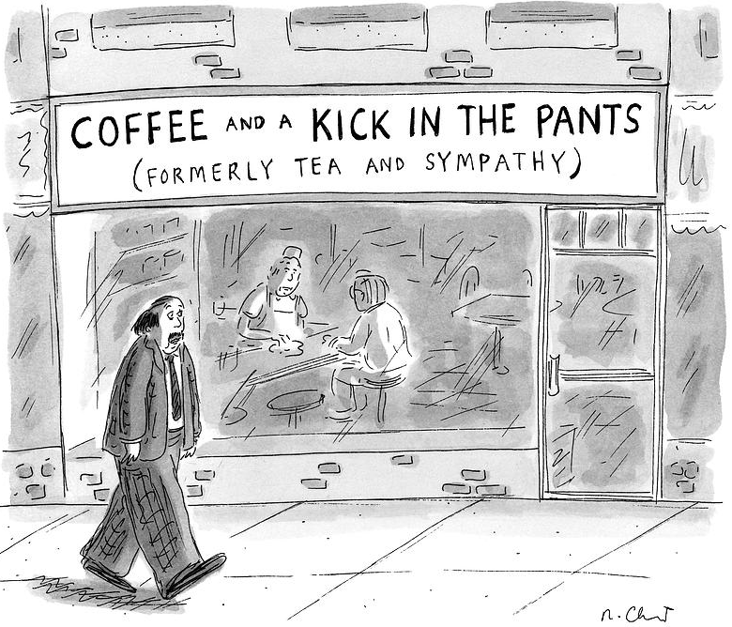
How we chose our content for today
Many lessons learned – the hard way…
Practical toolkit developed – that works
Value mandate – applies to telehealth
Vision for the future

Slide 8
Objectives
Learn how to adapt an information technology implementation framework to telehealth
Discover how to organize a telehealth services portfolio around value propositions
Discuss aspirational visions of digital delivery and discovery

Slide 9
Adapting an information technology implementation framework to telehealth

Slide 10
Review of Telehealth Service Implementation Frameworks
Implementation success rate disappointing
Successful pilots not sustained
Best-practice implementation approaches needed
Multi-faceted framework needed
Technology
Organizational structures
Change Management
Economic feasibility
Societal impacts
Perceptions
User-friendliness
Evaluation and evidence
Legislation
Policy and governance
Liezl van Dyk. Int J Environ Res Public Health. 2014 Feb; 11(2): 1279–

Slide 11
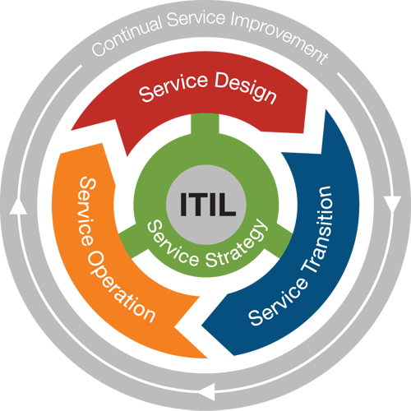
A Need for a Framework at MUSC
Created a lot of service development pieces (e.g. checklists)
Experienced a lot of growing pains
Experienced “concentration risk”
Needed a framework to put it all together
Understand strengths and weaknesses
Leveraged ITIL (Information Technology Infrastructure Library)
Set of detailed IT service management practices
Aligns service needs with business needs

Slide 12
Telehealth Service Framework
Telehealth Service Strategy
Ensures strategy is defined, maintained pre-implementation
Telehealth Service Design
Consistent approach to design and development
Telehealth Service Transition
Period of testing through go-live
Telehealth Operations
Supports responsive and stable services
Continual Quality Improvement
Aligns services to customers’ needs
Telehealth Service Strategy
Telehealth Service Design
Telehealth Service Transition
Telehealth Operations
Quality
Continual
Improvement

Slide 13
MUSC Mission: “Telehealth for efficient, effective care”
Each new service rated for impact (positive, neutral, or negative) on the following stakeholders:
Patient
Referring provider
Consulting provider
Payer
MUSC Health system (as a whole)
The Center for Telehealth prioritizes services that:
Adds efficiency to care teams
Adds value to care over the continuum
Mitigates time and distance barriers to care
*A negative effect on one or more stakeholders is a non-starter
Notes:
prioritized based on the following criteria:
•Support of implementation
•physician champion, provider
capacity, strategic alignment
•Potential impact
•Quality, cost, access to care
•Growth opportunity
•Market size, saturation, demand

Slide 14
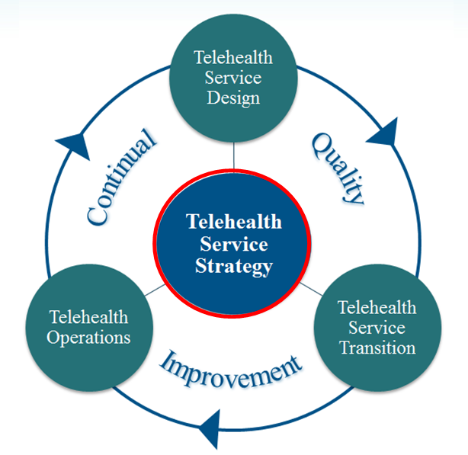
Telehealth Service Strategy
Ensures strategy is defined, maintained and then implemented
Key Processes
Strategy Management
Demand Management
Portfolio Management (services, sites, tech)
Financial Services Management
Business Relationship Management
Define scope of the service
Condition(s)
Location of the patient
Type of providers
What problem is being solved?
Notes:
At core of framework
Dedicated Coordinator as point of contact

Slide 15
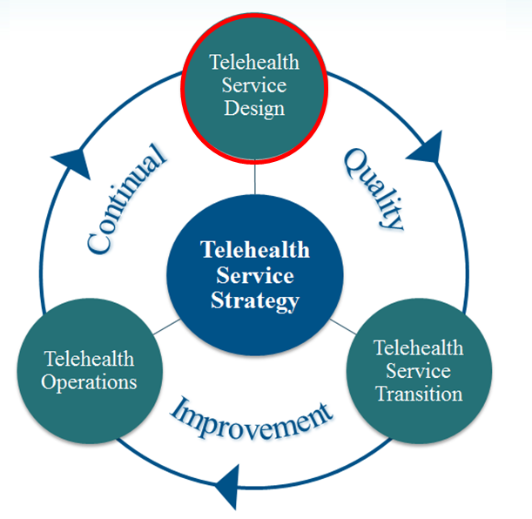
Telehealth Service Design
Clinical and operational protocols drafted
Test scripts customized
KPI’s identified
Compliance, legal, credentialing
Key processes
Design Coordination
Availability Management (tech and clinical)
Capacity Management (tech and clinical)
Information Security Management
Training Management (internal staff, providers, sites)
Notes:
The “build” phase
Use of a common architectures while still understanding that each “site of care” has different rules
Use RACI matrix: Responsible, Accountable, Consulted, Informed

Slide 16
Design Coordination Purpose – maintain coordination and control through a common architecture for all activities and processes in the design of new telehealth services
Operations
Design
Transition
Meet the needs of the customers!
Clinical
Protocols
Workflows
Technology
Equipment and Site Assessment
Procurement
Administrative
Legal
Credentialing - Regulatory
Outcomes
Performance Metrics
KPI Tracking
Billing - Compliance
Outcomes Reporting
Installation
Test Scripts
Strategy
Training
Equipment
Workflow
Mock Calls
Technology Pre-check
Dedicated Support
Go-Live
Dedicated IT Support
Dedicated Operational Support
Define scope of the service
Condition(s)
Location of the patient
Type of providers
What problem is being solved?

Slide 17
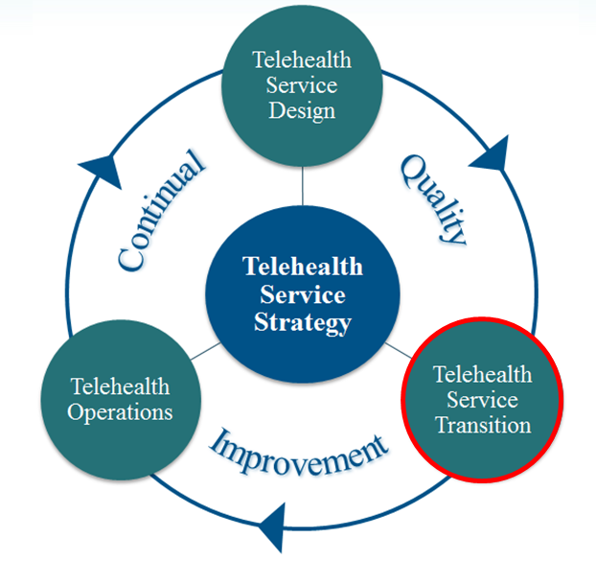
Telehealth Service Transition
Moves from test to go-live
Training – tech and workflow
Mock calls
Change management
Key processes:
Transition Planning & Support
Data & Knowledge Management
Change Management
Go live needs:
Strong communication
Strong IT support
Strong operational support

Slide 18
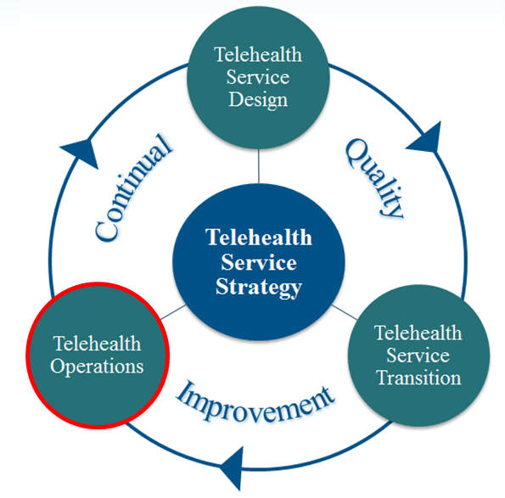
Telehealth Service Operations
Live and operational
Processes to manage “incidents”
Key processes
Incident Management
Problem Management
Access Management
Ensure service is meeting the needs of the customer
Patients
Internal providers
External providers
Collective teams in between them that coordinate the delivery of the service
Notes:
incidents” – any unplanned event that has a negative impact on normal operations (could be personnel, process, technical)

Slide 19
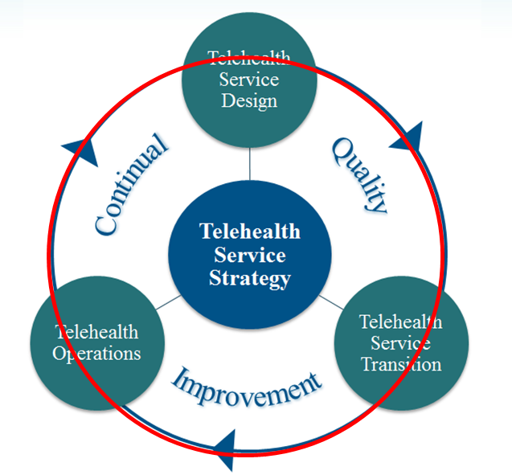
Continual Quality Improvement
Occurs throughout the lifecycle of the framework
Aims to align and realign the telehealth service to the ever-evolving customers’ needs
Key process
7-Step Improvement Process
Case presentations in collaboration with external partners
Striving for high-reliability
Notes:
Case presentations in collaboration with external partners – offers professional development opportunities and creates lessons learned for our collective teams

Slide 20
Organizing a telehealth services portfolio around value propositions

Slide 21
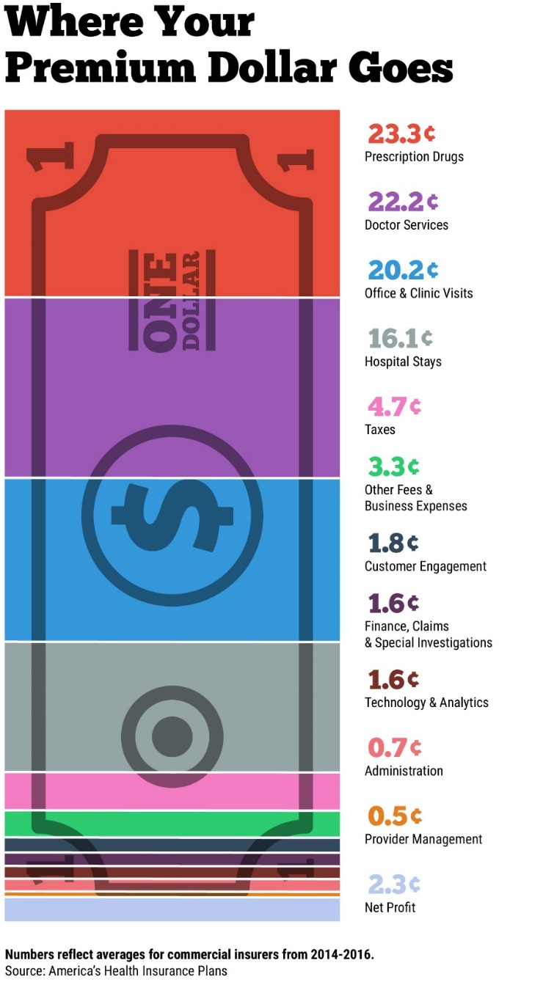
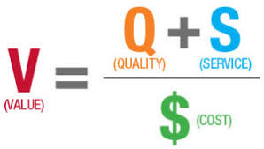
Not another dollar in the system…

Slide 22
Primary Value-Based Strategy
Value
Hospital Support Services
Business Health
Institutional Facility Support Services
Primary Care Support Services
MUSC Service Extension
Priority Health Disparities
Cost Avoidance

Slide 23
Hospital Support Services: Telestroke

Slide 24
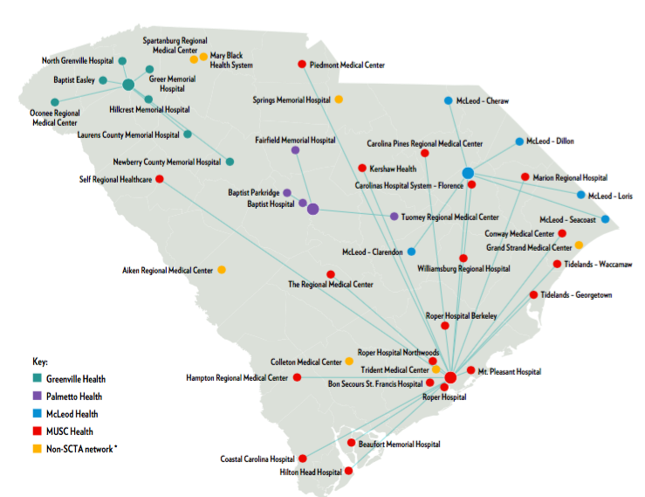
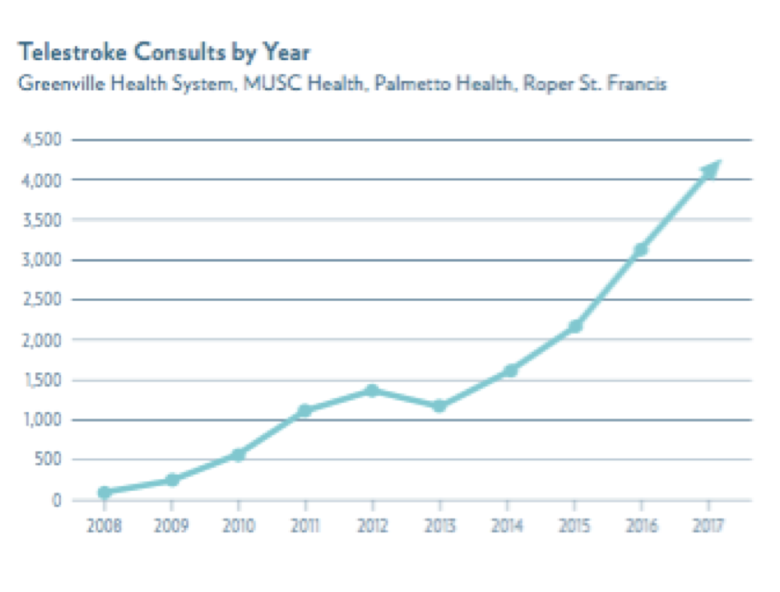
Hospital Support Services: Telestroke

Slide 25
Hospital Support Services: Telestroke

Slide 26
Primary Care Support: Teleconsultation

Slide 27
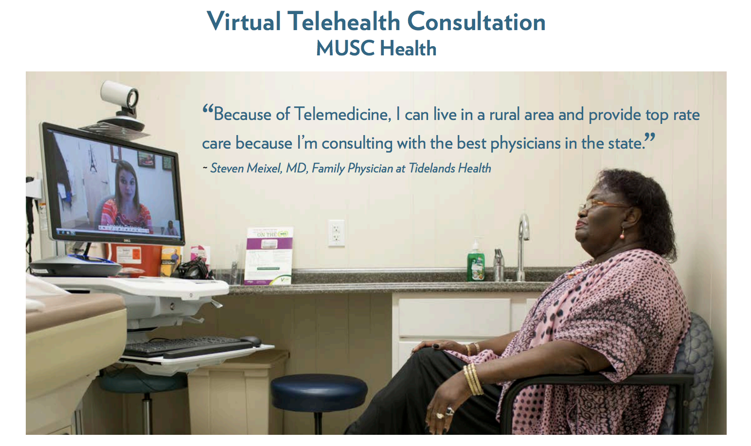

Slide 28
Primary Care Support: Remote Patient Monitoring

Slide 29
Reducing Health Disparities: School-Based Telehealth

Slide 30
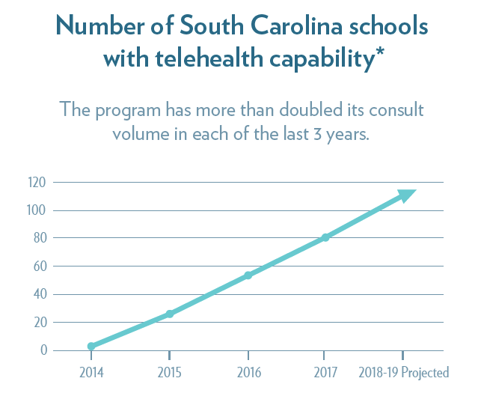
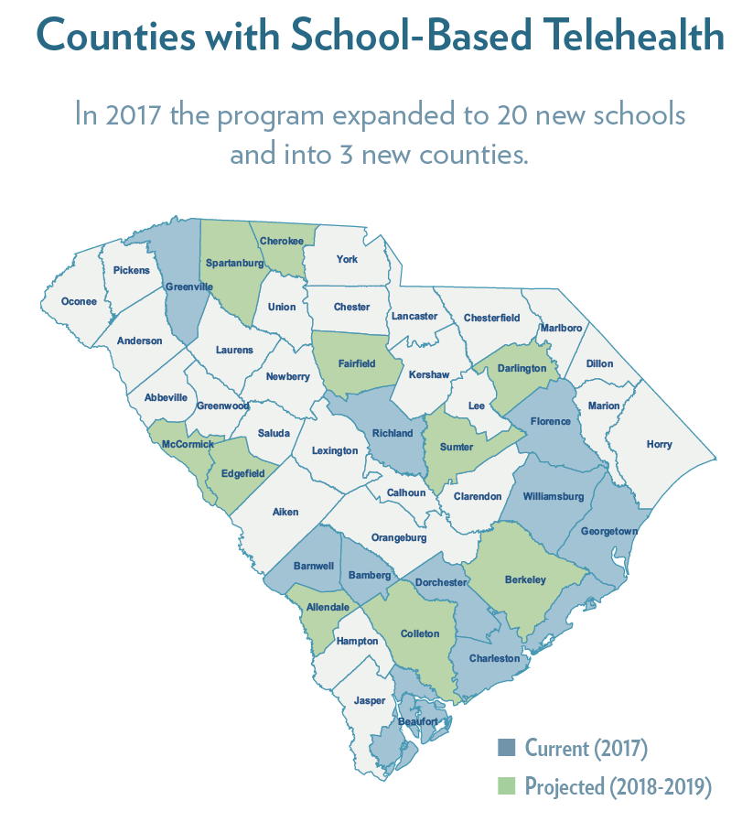
Explosive Growth in School-Based Telehealth

Slide 31
Aspirations for the future: Digital delivery and discovery

Slide 32
Digital Health Delivery and Discovery Institute
Provider centered decision making tools
Acute Illness
Chronic Disease Management
Wellness Care
Individualized Patient Care Plans
Precision Population Health Interventions
Predictive Market Trends
Distant Hospitals
Clinical Data
Big Data
Analytics
Patient Homes
Digital Health Service Development
Digital Health Discovery
Data Analytics
Human factor informed patient interface
Data Capture
Data Transformation
Data Consumption
Precise Decision Making
Population Identification

