Slide 1
Blockchain & Belief Systems in Healthcare October 2018 @johngbass, @HashedHealth

Slide 2
Disclaimers & Hashed Context
Thesis:
Protocol-agnostic
B2B before B2C
Community Development + Market Development + Product Development
Built on Learning / Experimentation
Belief that Costs Are Not Sustainable
Enterprise Clients
Providers
Payers
Non-Profits
Federal
State
Technology Vendors
proportional.io

Slide 3
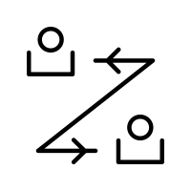
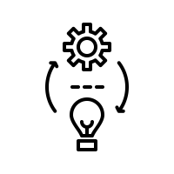
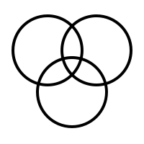
Context: “Blockchain” & DLT
 | The Blockchain is a time-stamped registry that securely records & shares transactions / events / data across a network.
 | Public or private records are linked using cryptography, creating an immutable record of events that can be used to enforce business rules (“smart contracts”) across a market without a third party governor.
 | It is a transformative new way of developing “market-level” products.
 | “Blockchain” represents a spectrum of technologies ranging from Distributed Ledger Technology (DLT) to open, decentralized protocols that power distributed networks. Protocols and solutions inherit the belief systems of their creators and operators.
Notes:
DLT is like blockchain’s less disruptive little brother

Slide 4
What Do You Value? What Are You Solving?
censorship resistance,
privacy,
permissioning,
throughput,
payload,
data elements,
scalability,
business model constraints,
governance constraints,
…
DLT
Private, Permissioned
Blockchain
Open & Decentralized
Enterprise
Meaningful Work 2018-2021
Corporate Belief Systems
Centralization / Centralized Validation
Low Barriers To Adoption
Consumer
Disruptive 2022+
Consumer Belief Systems
Independent Validation
High Barriers to Adoption

Slide 5
The Internet of Value
Gartner: $3T by 2030
 | www | www 2.0 | www 3.0
Primary focus | information | reputation | value
Primary unit | search / links | likes | assets
Dominant Platform | Google | Facebook | ?
Digital Assets = Value Instruments
Governance = Rules By Which Assets Markets Are Operated, Assets Created / Exchanged
Mass coordination / collaboration
Open source
More resilient
Less fragile
Notes:
Vs closed proprietary systems and business models
Inherently more efficient, effective, sustainable, equitable way to innovate in healthcare

Slide 6
Blockchain Belief Systems
Belief System | Libertarian / Digital Money Send Currency Without ”Trusted Intermediaries” Censorship Immutability Decentralization | Developer / Smart Contracts Send Digital Assets Without Middleman if/when… Internet of Value | DAOs / Virtual Orgs (Rules in smart contracts) Ocean (Staking) Tezos (Onchain Governance) Concepts Represent Belief System of Communities (decentralization, automation, ethics, environment, tax collection, value extraction) (when designed well)
Founding | Satoshi Nakamoto 2009 | Vitalik Buterin 2015 | 2017, 2018 +
Notes:
Bitcoin- a bundle of pre-existing tech brought together to solve the problem of “trusted intermediaries.”
Tezos- community voting
DFINITY- retroactive changes
Ocean- reputation / staking
Next gen DAOs: Aragon, DigixDAO

Slide 7
Belief Systems in Healthcare
Network Governance
Degrees of Trust, Transparency, Incentive Alignment
Broad Examples in Health:
Behavioral Economics
Value-Based Care
Impact Bonds / Outcomes Based Financing
Self-Sovereign Identity
Community-Owned Infrastructure

Slide 8
Healthcare: Working As Designed
Corporate-Focused / Data-Focused
Transactions.
Lacks Consumer Choice.
Irrational Pricing.
Less Competition.
Massive Infrastructure Bloat.
Massive Administrative Burden.
Development on Silo’d Systems.
Hacks & Privacy Concerns.
The Big Problem: Prices & Cost
18% of GDP in 2018
>$5.7T by 2023
1/3 Administrative Waste
Notes:
As we approach 20% of GDP
As we hear stories of abusive behaviors where, in some ways, corporations compete with consumers
The opportunity to introduce new belief systems rises.

Slide 9
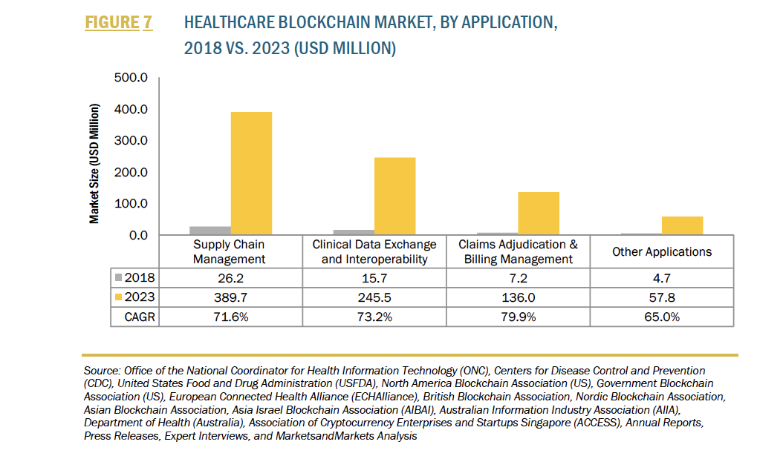
Healthcare Blockchain: 2018 Market Applications
Trend
B2B
DLT
Corporate Governance / Belief Systems
Solve Problems

Slide 10
Governance Opportunities & Challenges
Solving problems that set the stage for disruption & decentralization
The problem = cost
Real B2B > Future B2C
MVN + MVP
Social > Technical
Business Model 10x
Business Model
Technical Model
Finding this is hard
but rewarding.
Governance Structure
(Belief Administration,
Value Accrual)

Slide 11
Beliefs
Transition to Rational, Decentralized Markets
Seller Competition, Consumer Choice
Alignment with Buyers & Sellers
Business Model
Technical Model
Governance Structure
(Belief Administration,
Value Accrual)

Slide 12
proportional.io
Beliefs
Transition to Value Based Care
Privacy
B2B Alignment
Business Model
Technical Model
Governance Structure
(Belief Administration,
Value Accrual)

Slide 13
Beliefs
Transition to Industry Utility Model
Open Marketplace
B2B Before B2C
Payers & Health Systems
Business Model
Technical Model
Governance Structure
(Belief Administration,
Value Accrual)

Slide 14
Governance As The Last Mile
Business Model
Technical Model
Governance Failure: 340b
Governance Structure
(Belief Administration,
Value Accrual)

Slide 15
The Power of Belief Systems in Healthcare
Change is coming …
New methods of building infrastructure & apps that embed belief systems such as behavioral economics, value-based care, self-sovereign identity, corporate “ecosystems of shared value.”
New business models designed for network effects.
New economies / markets / value chains.
New actors & new jobs.
Notes:
This technology is here and is not going away. It is likely to change healthcare. It may disrupt some businesses. Unclear which, so it’s smart to get in the game.
Reason for this disruptive potential lies in the concept of embedding trust & belief systems in the software. Doing this allows us to re-think value chains. Creates a new substrate for development of market level solutions. Enables new business models. Introduces new actors and new jobs.
Honored
Happy to answer questions.

