Slide 1

Validated
Use Cases
Frank Ricotta
Wendy Charles
Kenneth Colón
ConV2X
15 October 2019

Slide 2


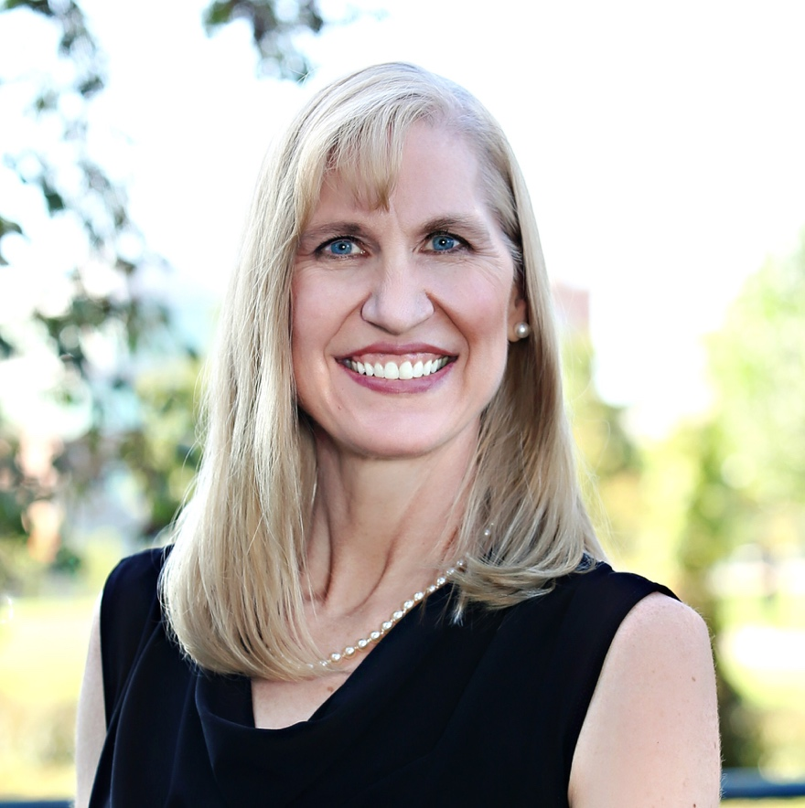
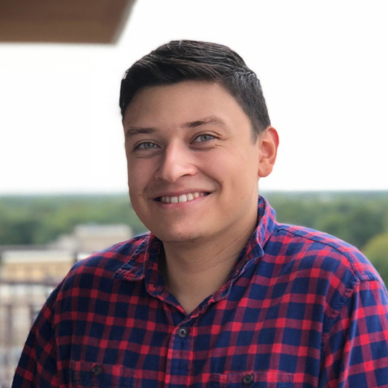
Speakers
Frank Ricotta
Wendy Charles
Kenneth Colón

Slide 3
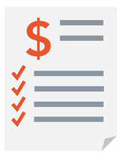




Blockchain health applications
SUPPLY CHAIN, PHARMACY & CUSTODY
Chain of Custody
Protocol Adherence
Prescription Misuse / Fraud
Asset Tracking
OPERATIONS & ADMINISTRATIVE
Interoperability and Transperancy
Claims Auto-Adjudication
Revenue Optimization & Recovery
Authorizations
Work Flow Optimization
Clinical Decision Collaboration
RESEARCH
Intellectual Property Ownership
Clinical Trial Recruitment
Research Collaborations
Investigator-CRO-Sponsor Data Sharing
IDENTITY & CONSENT
Identity Verification
Master Patient Index (MPI)
Provider Directory
Licensure & Credentials
Data Access Tracking
Informal to Informed Consent
GOVT & REGULATORY
Regulatory Compliance
Fraud Prevention
Cross-Agency Data Sharing
Mandatory Reporting
Social Services

Slide 4
Data is the Foundational Use Case
For care, For health, For life

Slide 5


Identity, Health Profiles, and Consent

Slide 6


A Global Sovereign Health profile
For People, Places, and Things
A COMMON IDENTITY TRUST FABRIC
MPI
Fitness Data
Government ID
Public Records
Verified & Self Attested Attributes
Verified & Self Attested Attributes
Health Record
Professional
Credentials
Bank Account
Sovereign ID (s)
Diverse data sources form the basis for universal identity & profile management

Slide 7
Three parts to identity
Claims
  Identity claim made by the person our business
Proofs
  Evidence such as a document that provides evidence for the claim
  Can come in all forms: Drivers license, passport, birth certificate, utility bill
  Two key items to open a non resident bank account in Bermuda: Government ID and copies of utility bill to demonstrate residency.
Attestation
  Third party validation of the claim/proof

Slide 8



You control your on-line persona
Anonymous
Partial or Alias
Everything

Slide 9
Granular informed Consent
An Ecosystem of Managed Interactions, Data Sharing, and Monetization

Slide 11
Blockchain & Machine Learning for Provider Data

Slide 12
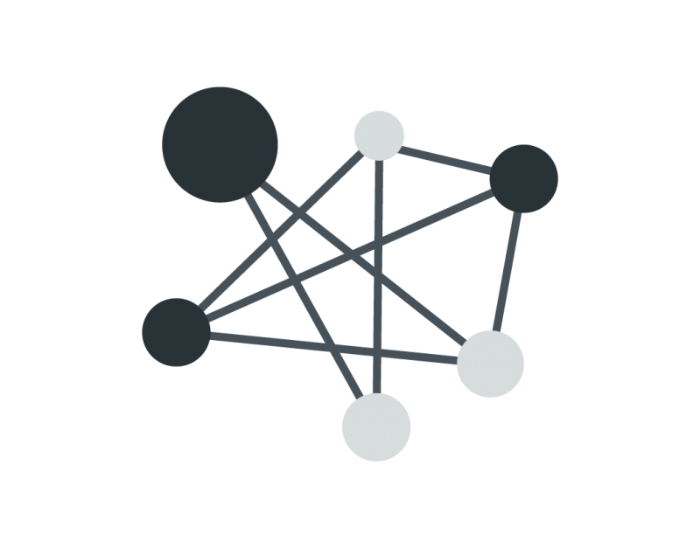
What is Provider Data?
Contact Information
  Multiple Addresses + Phone #s
Professional Information
  Training, Specialties and Credentials
Network Status
Panel Status

Slide 13
The Status Quo
$2B+ spent annually by health plans (CAQH)
Provider directories are <50% accurate (CMS)
1 in 7 patients receive a surprise bill due to inaccurate network information (HCCI)

Slide 14
The Status Quo
Regulatory Actions
  Federal fines ($25,000 per beneficiary)
  Mandated reimbursements
  Blocks on new enrollments

Slide 15
Orderly’s Approach
1B+ data points from public and proprietary sources
Machine learning engine
Results:
  ≥90% accuracy
  ≥75% cost-savings

Slide 16
Challenges
How do we securely store this data?
How do we manage sharing this data?
How do we create an audit trail for regulators?

Slide 17

Joint Solution
+

Slide 18

Key Benefits
SECURITY
ACCURACY
SHARING
AUDITABILITY

Slide 19
Blockchain-Enabled Data Aggregation in Clinical Health Data Organizations

Slide 20

Situation
Colorado clinical health data organizations:
Colorado Regional Health Information Organization (CORHIO)
Quality Health Network (QHN)
Colorado Community Managed Care Network (CCMN)
Required to provide quality metrics for
state-run federally-qualified health programs
Notes:
Three of Colorado’s clinical health data organizations, Colorado Regional Health Information Organization (CORHIO), Quality Health Network (QHN) and Colorado Community Managed Care Network (CCMCN), partnered with BurstIQ. These organizations were required by the state of Colorado to provide quality reporting metrics for state-run federally-qualified health programs, such as Colorado Access, CHIP, HRSA-supported network.

Slide 21



Goals
Share data for aggregated CQM reporting
Protect data confidentiality
Reduce administrative costs and burdens

Slide 22
Solution
Data organizations partnered with BurstIQ in August 2018
Placed clinical quality measures (CQM) on HIPAA-compliant blockchain
Funded by Colorado State Innovation Model program
First-of-its-kind project and partnership in Colorado

Slide 23

INTEROPERABILITY
True Data Liquidity Between Endpoints, Stakeholders & Systems
STATE-RUN TOOLS
Notes:
On a system level:
True data liquidity between endpoints
Many of these endpoints are both a data input endpoint and a data visualization tool
Each system needs access to a subset of the complete longitudinal record – consent contracts control this

Slide 24
How it Works
The blockchain-based platform allows:
Interoperability across organizations
Data consolidation and contextualization
Data sharing without revealing individual data points to each other
Data standardization without having to change internal organization standards
Accessibility to complex set of stakeholders

Slide 25
How it Works
Complex ownership and granular consent allows each organization to:
Control own data
Specify how data move between different stakeholders
Automate permissible access and data uses
Notes:
Frame of reference about granular consent:
GDPR Article 6, Recital 32 : “Consent should cover all processing activities carried out for the same
purpose or purposes. When the processing has multiple purposes, consent should be given for all of
them”.
Comment from the WP29 guidelines on granularity and freely given consent: “If the controller has
conflated several purposes for processing and has not attempted to seek separate consent for each
purpose, there is a lack of freedom. This granularity is closely related to the need of consent to be
specific…when data processing is done in pursuit of several purposes, the solution to comply with the
conditions for valid consent lies in granularity, i.e. the separation of these purposes and obtaining
consent for each purpose”.

Slide 26
Results
Reducing administrative burdens of aggregating CQMs
Simpler process for extracting and reporting organization-level and consolidated results
More privacy and control over data

Slide 27
Initial Challenges
Questions about jurisdiction
Need for:
  Governance structures with layers of decision-making
  Data management policies
  Stakeholder and community education about blockchain

Slide 28
Future Potential
Building out data ecosystems across other state agencies or health service providers
More consumer-directed data sharing options (e.g., research, marketplace services)
Research and public health surveillance:
  Massive data sets for analysis without access
  to individual data points
  Longitudinal analyses for trends

Slide 29


