Slide 1
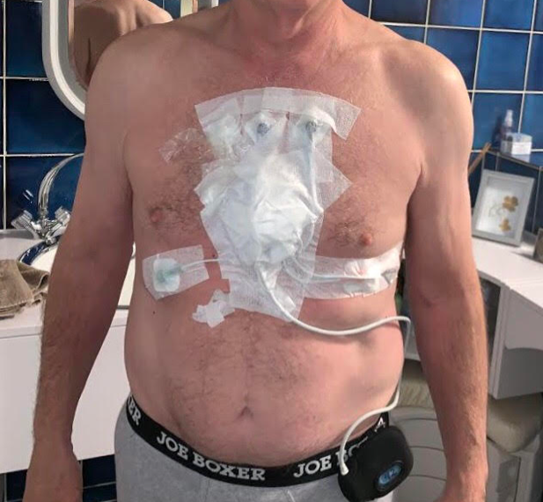
Problem
Vital Signs
Monitoring at Home
Medical devices not acceptable for long-term use.
Wearables not designed for at-risk population.
Post-acute/Rehab programs need solutions for long-term monitoring.
Notes:
We have the most advanced product, because we know the industry worldwide, and we know we are years ahead competition.

Slide 2
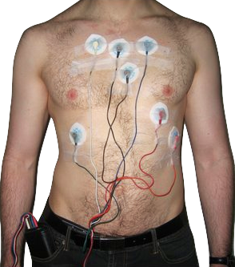
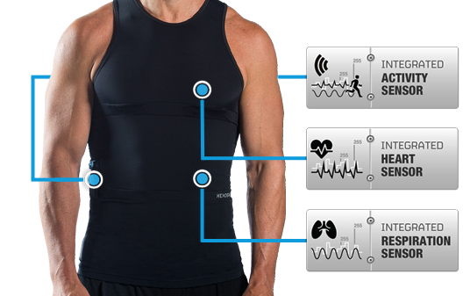
Notes:
We have the most advanced product, because we know the industry worldwide, and we know we are years ahead competition.

Slide 3

Notes:
Bonjour et merci de me recevoir pour présenter notre entreprise.
Je m’appelle Pierre-Alexandre Fournier, je suis président et co-fondateur de Carré Technologies, qui commercialise un produit unique pour la mesure de la santé qu’on appelle Hexoskin.

Slide 4



Remote Clinical Trials for Rare Diseases
Notes:
Bonjour et merci de me recevoir pour présenter notre entreprise.
Je m’appelle Pierre-Alexandre Fournier, je suis président et co-fondateur de Carré Technologies, qui commercialise un produit unique pour la mesure de la santé qu’on appelle Hexoskin.

Slide 5


Deep Learning Can Build Rich Models
Large datasets allow the development of rich models…
Small datasets can be used to increase performance
Preparation and Data Processing:
Data Recording and Coding
Data Mining
Data Conditioning
Statistical Analysis
Statistical Modeling
Data Flow Automation
Graphical Analysis
                Reproduce Studies
                Answer Questions
                Validate New Endpoints (with Respiratory, Sleep)
                Develop New Machine Learning Algorithms
                Integration Documentation and Code
Transparency
Can it be explained, compared, reproduced?
Medical
Inputs
Inferred
Data
Deep Model
EHR data
90%
=
Vitals time series
Laboratory
…of the work
Imaging
10%
DNA
Other
Copyright 2019 Hexoskin (Carré Technologies Inc.)
Notes:
Hexoskin’ Data science team has a long experience with :
Large physiological data sets
Tests results
Time series
Analyzing datasets of Thousands of people at once
Terabytes of data
We developed and use Industrial solutions for data management

