Slide 1
Developing Evidence for Telehealth Effectiveness Francis X. Campion, MD, FACP Group Leader, Health AI MITRE Corporation
ConV2X, 10/11/2022
Approved for Public Release; Distribution Unlimited. Public Release Case Number 22-3236

Slide 2
Outline
What is telehealth?
What is “effective” telehealth?
Dimensions of telehealth effectiveness:
Clinical outcomes
Patient experience
Provider experience
Cost, Utilization and Equity
Telehealth Impact Study
AHRQ Effective Healthcare Program: Antenatal care; Remote Monitoring
AMA Digital Health Research: physician surveys

Slide 3
What is Telehealth?
As defined by the Health Resources Services Administration (HRSA) telehealth means the use of electronic information and telecommunications technologies to support long-distance clinical health care, patient and professional health-related education, public health, and health administration. Technologies include videoconferencing, the internet, store-and-forward imaging, streaming media, and terrestrial and wireless communications.
(ref.) What Is Telehealth?, U.S. Dep't of Health & Human Servs., Health Rsch. & Servs. Admin. (last updated Mar. 2022), https://www.hrsa.gov/​rural-health/​telehealth/​what-is-telehealth.

Slide 4
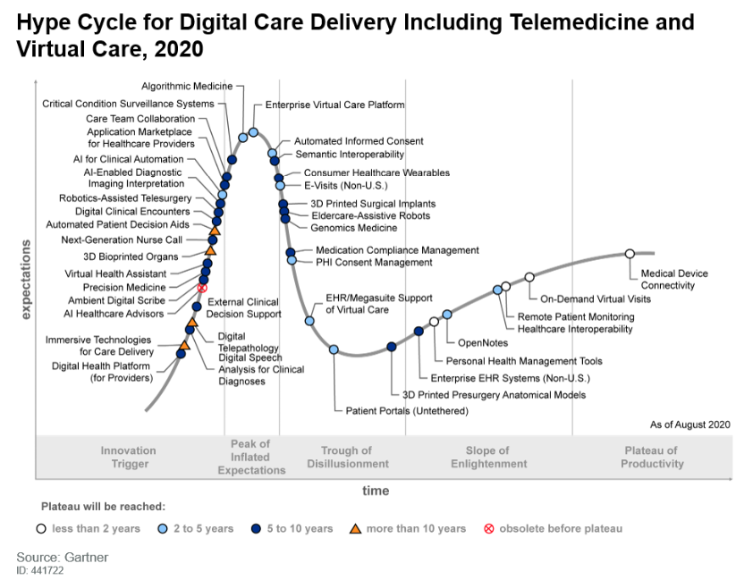
Notes:
There are many different technology solutions under the umbrella of “digital care delivery”
Which represent “telemedicine”? …. Perhaps the closest is “on demand virtual visits” and “remote patient monitoring”

Slide 5
“Ideal study design” for telehealth effectiveness
Comparison of Telehealth vs “usual care” (face to face)
Large sample
Diverse populations
Measurable outcomes
Clinical outcomes
Patient satisfaction
Provider satisfaction
Cost
Conclusion: We need both prospective randomized studies and retrospective observational studies. We need quantitative and qualitative research designs.
Challenges:
- Is it ethical to randomize to “usual care”
during a pandemic?
- How to standardize the “dose of telehealth?”
Clinical outcomes may take a long cycle time.
How to capture “costs to the patient” such as
travel time and work time lost?

Slide 6
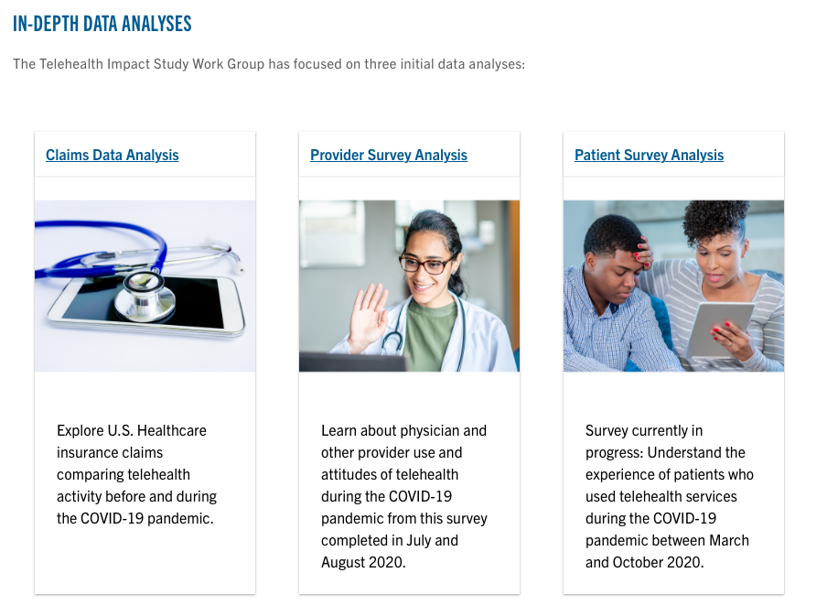
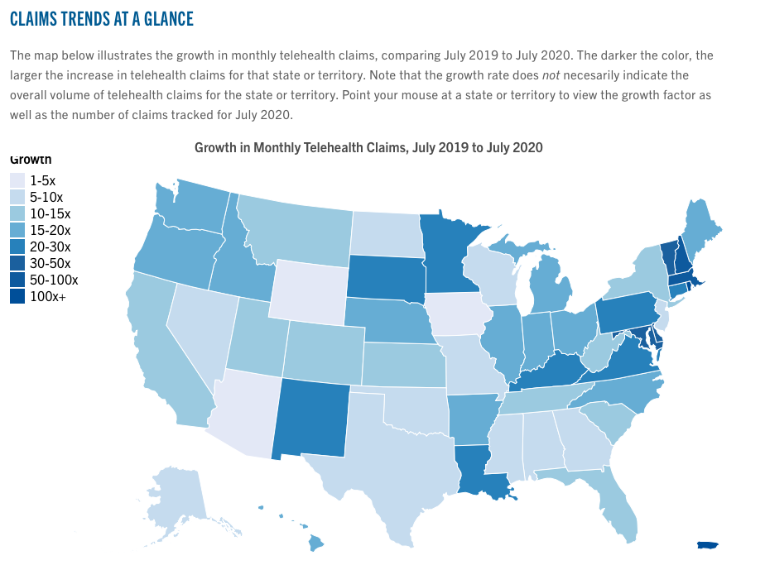
Telehealth Impact Study
c19hcc.org/telehealth/impact-home/
COVID-19 Healthcare Coalition
C19HCC.ORG
Notes:
I am very pleased to join with you today to discuss the findings from our COVID-19 Telehealth Impact Study. The study was started just one year ago as a voluntary effort as part of the COVID=19 Healthcare Coalition. The Coalition was created as a private sector response to the many challenges of the COVID19 pandemic. In March of last year, Dr. John Halamka from Mayo Clinic and Dr. Jay Schnitzwer from MITRE reached out to colleagues across the health care community. Within a matter of weeks, over 1000 member organizations joined the Coaltion. We formed 15 working groups to address topics such as PPE, COVID19 testing, ventilator management and of course, telehealth. The Telehealth Work Group realized we er
The Telehealth Impact Study is actually 3 studies. We explore the rapid growth of telehealth in the United States during the COVID-19 pandemic through claims data trends and surveys.
1) Claims Analysis has published national trends already; state trends and case studies are being developed by research team.
2) Physician Survey (physicians and qualified healthcare professionals) was completed in summer 2020.
3) Patient Survey will initiate in November 2020

Slide 7
COVID-19 Telehealth Impact Study: Research Team

Slide 8
Telehealth Explosive Growth During COVID-19 Pandemic
Notes:
Data Source: De-identified claims data is provided by Change Healthcare. Claims represent over 50% of all private healthcare claims in the United States. This dataset draws from all 50 states and most healthcare settings. Although the dataset does not include indemnity Medicare and Medicaid, it does include a large number of Medicare Advantage and Medicare HMO claims. (Change Healthcare is not a division of Optum, since acquisition in January 2021.)

Slide 9
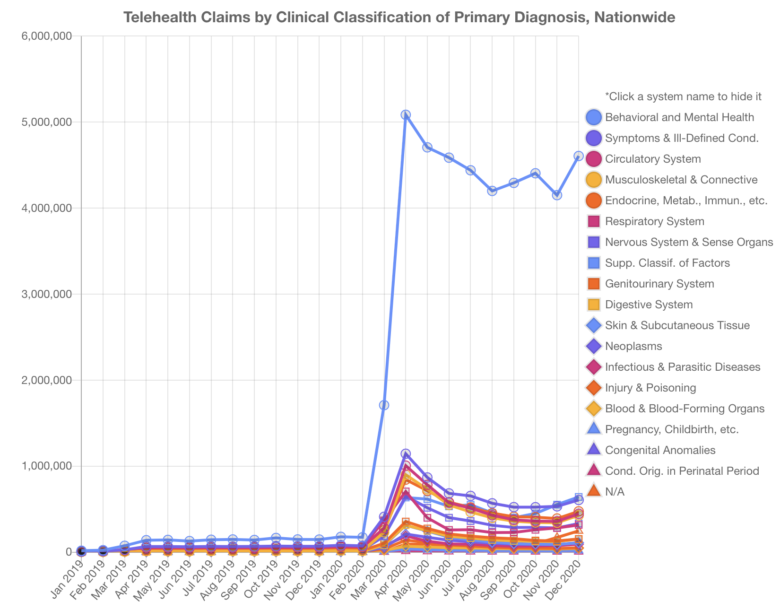
What medical problems are being addressed with telehealth?
9
Notes:
Clinical classifications are grouped by ICD-10 codes using Clinical Classifications Software (CCS) developed by the Agency for Healthcare Research and Quality (AHRQ).
Telehealth visits for behavioral and mental health diagnoses are 5-10x more frequent than other diagnosis categories. Even before the pandemic, behavioral and mental health was leading. During the April – May 2020 timeframe, telehealth claims rose dramatically for all diagnosis classes. However, behavioral and mental disorders rose even faster than did prevalent medical categories such as Circulatory System and Endocrine disorders.
Jan.2020: BH:Circulatory = 2.8x, BH:Endocrine=4.7x;
May 2020: BH:Circulatory = 6.1x, BH:Endocrine=6.7x

Slide 10
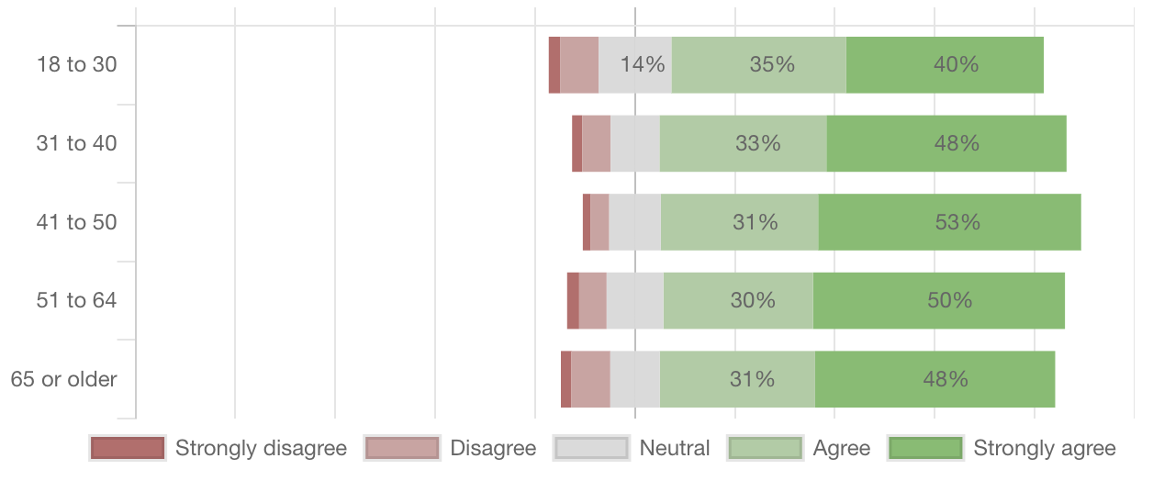
PATIENT
SURVEY
The provider was thorough.
10

Slide 11
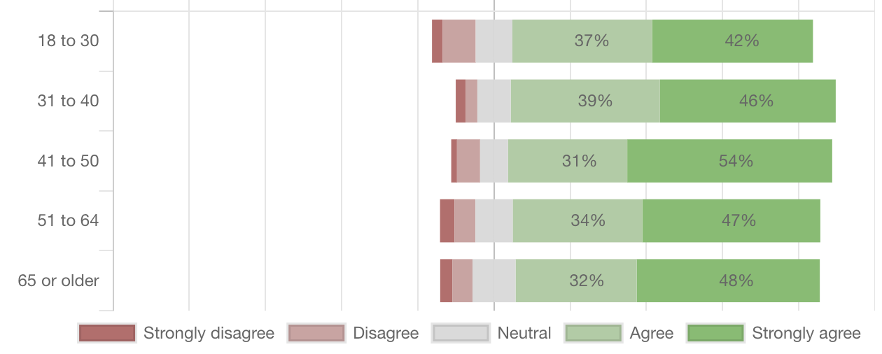
PATIENT
SURVEY
The quality of the patient-provider communication was good.
11

Slide 12
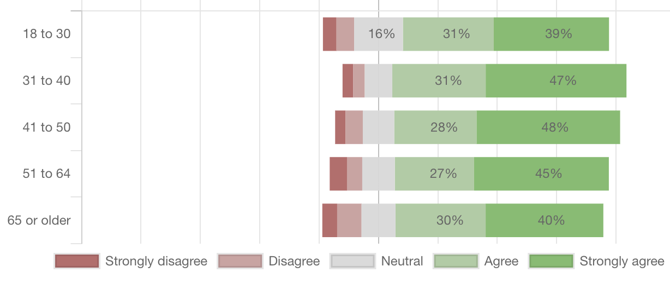
PATIENT
SURVEY
I will continue to use telehealth services into the future.
12

Slide 13
AHRQ: Effective Health Care Program – Study of Telehealth During COVID-19
Notes:
Agency for Healthcare Research and Quality (AHRQ) Evidence-based Practice Center (EPC) program just started a new topic refinement and systematic evidence review on “Telehealth During COVID-19”. This was a topic that was nominated by the Learning Health System panelbeing engaged by AHRQ to improve adoption of evidence.
Public comments are being solicited with a deadline of July 8, 2021. The scope and key questions for the review are currently posted on the Effective Health Care website: https://effectivehealthcare.ahrq.gov/products/virtual-health-covid/key-questions
The Effective Health Care (EHC) Program improves the quality of health care by providing the best available evidence on the outcomes, benefits and harms, and appropriateness of drugs, devices, and health care services and by helping health care professionals, patients, policymakers, and health care systems make informed health care decisions.

Slide 15
AHRQ: Schedule of Visits and Televisits for Routine Antenatal Care: A Systematic Review (June 2022)
Methods: 2 RCTs, 4 NRCSs, one survey compared telehealth vs in-person antenatal care; 5 qualitative studies
No difference in preterm births, NICU admissions
Satisfaction: mixed results with one study showing greater satisfaction with telehealth, one showing greater satisfaction with in-person care
Qualitative studies: improved access and continuity with TH but concern for risk of hampering provider-patient relationship development and concern that TH may hamper safety and widen health disparities
Insufficient evidence: QOL, mental health, lost work time, low birthweight, Apgars
Further research is needed
https://effectivehealthcare.ahrq.gov/products/schedule-visits-antenatal-care/research
Notes:
The evidence allowed few specific conclusions. Generally speaking, studies did not report negative effects to reduced schedules of antenatal care or the incorporation of televisits into antenatal care. Although providers and patients had some concerns about reduced visit schedules and use of televisits, several potential benefits were also noted. While the evidence appears to be applicable to a range of populations and settings, there is insufficient evidence about how changes in visit numbers or use of televisits may impact different populations, especially as concerns health disparities, inequities, and social determinants of health. Future research is needed that includes outcomes of most importance and relevance to changing antenatal care visits. Until there is further evidence to provide more definitive conclusions, other factors, importantly patient preferences, may be important to help decide whether or not to implement reduced antenatal care schedules and/or substitute telehealth for select antenatal care visits.

Slide 17
AHRQ: Automated-Entry Patient-Generated Health Data for Chronic Conditions: The Evidence on Health Outcomes (March 2021)
Methods: 114 controlled studies that used 118 unique devices, 26 mobile apps
Findings:
Positive benefit: coronary artery disease, heart failure, asthma
Unclear benefit: obesity; lack of effect of PGHD on BMI
Unclear benefit: hypertension but possible positive effect on blood pressure
Unclear benefit: Cardiac arrhythmias but consistent benefit for time to arrhythmia detection
Unclear benefit: COPD, diabetes prevention, sleep apnea, stroke, Parkinson’s dz
https://effectivehealthcare.ahrq.gov/products/health-data-mapping/report

Slide 18
Patient-Generated Health Data for Chronic Conditions
“Multiple randomized controlled trials (RCTs) have evaluated some PGHD technologies (e.g., pedometers, scales, BP monitors), particularly for obesity and hypertension, but health outcomes were generally underreported. We found evidence suggesting a possible positive effect of PGHD interventions on health outcomes for four chronic conditions. Lack of reporting of health outcomes and insufficient statistical power to assess these outcomes were the main reasons for “unclear” ratings. The majority of studies on PGHD technologies still focus on non-health-related outcomes. Future RCTs should focus on measurement of health outcomes. Furthermore, future RCTs should be designed to isolate the effect of the PGHD intervention from other components in a multicomponent intervention.”

Slide 19
https://www.ama-assn.org/about/research/ama-digital-health-care-2022-study-findings

Slide 20
Notes:
The AMA has been interested in the topic of digital health care for many years. They began a survey process in 2016 and followed up with repeat surveys in 2019 and 2022.
This survey included 1300 physicians in each year, distributed among pcps and specialists. It is a relatively small survey, given that there are are an estimated 938,000 “active physicians” in the U.S.

Slide 21
Notes:
Back in 2016, the AMA identified 7 digital health applications. They included and differentiate two aspects of Remote Patient Monitoring. This was RPM automation of blood pressure and other biometrics to entry into the electronic medical record. The defined” RPM and management for improved care” as technology which additionally has automated alerts so the provider will be apprised of out of range or missing values.

Slide 22
Notes:
They asked questions relate to the drivers of technology adoption - This display shows the most important motivators for technology adoption, (based on the physician answers).
Physicians reported that improving health outcome was the most important driver of adoption as well as improving work efficiency, improving diagnostic ability , patient safety and patient adherence.
Way down in the lower left quandrant were the least important drivers – including “patient demand” for the technology, and the need to “differentiate my practice from others”.

Slide 23
Notes:
FEATURES of the technology which were most important to physicians included being well integrated into the EHR and whether or not it “Is proven to be as good or superior to traditional care.” This speaks to the need to perform and report studies. It is interesting that the requirement to be demonstrated in peer reviewed publications or validated by the FDA were neutral. It’s interesting to see this nuanced sentiment - it seems these 1300 physicians who completed the survey want to see some evidence, but perhaps it does not have to be quite as rigorous as requiring peer review.

Slide 24
Notes:
I encourage you to look up the AMA research presentation on the AMA website. They did a nice job of displaying their estimation of physician adoption of each of the 7 technologies ane the changes in sentiment over the three surveys (done in 2016, 2019 and 2022). In these summary diagrams they report that RPM, remote patient monitoring, is still early in the technology adoption cycle and gaining steady progress over these 6 years.

Slide 25
Notice of Proposed Rulemaking: Nondiscrimination in the Delivery of Health Programs and Activities Through Telehealth Services (§ 92.211) (August 2022)
Specifically, proposed § 92.211 provides that a covered entity must not, in delivery of its health programs and activities through telehealth services, discriminate on the basis of race, color, national origin, sex, age, or disability.
…studies also indicate disparities in access based on race and disability. One study found “significant” racial disparities in telehealth use during the COVID-19 pandemic, which the authors believe may lead to the worsening of pre-existing health disparities.^{[583]}
….challenges include inaccessible telehealth platforms and other barriers to communication with individuals who are deaf, blind, or have cognitive disabilities.^{[587]}
https://www.federalregister.gov/documents/2022/08/04/2022-16217/nondiscrimination-in-health-programs-and-activities
Notes:
Note: published research on telehealth REALLY MATTERS. See this reference to telehealth ”studies” in the currently evolving federal regulation. This Notice of Proposed Rulemaking was posted in the Federal Register and invites the public to comment. The comment period ends in early October, 2022 for this rule related to the need to avoid discrimination in the use of TH services.

Slide 26
Summary
We are in the midst of a great experiment! We are witnessing the rapid transformation of care delivery to a full embrace of telehealth.
Evidence of telehealth effectiveness will inform new payment rules and regulation.
It is the responsibility of pioneers and early adopters to study the effectiveness of telehealth so that we can guide its beneficial impact for patients.
Please study your telehealth implementations and share your results.
Commit to measuring clinical outcomes, satisfaction, equity, and cost
Publish both positive and negative findings
Thank you!
F.X. Campion, MD, FACP; fcampion@mitre.org
Notes:
What is ”effective healthcare?”
FXC: Effective healthcare is care which achieves control of healthcare symptoms or cure of disease in manner which is respectful and accepted by the patient.

