Slide 1



The Digital Mindset - Data as Strategy
How Platforms Solve Problems and Ecosystems
Transform Industries

Slide 2
What the data explosion means for understand each unique person/patient
Source: Gartner 2022
Data deepens the phenotypic, genotypic, multi-omic, molecular, behavioral and environmental understanding

Slide 3
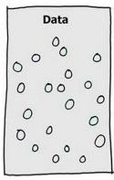
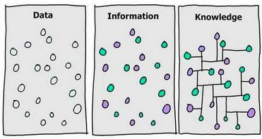
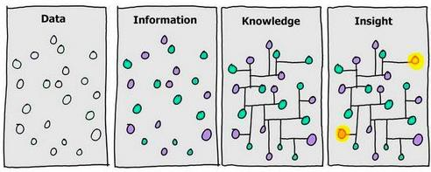
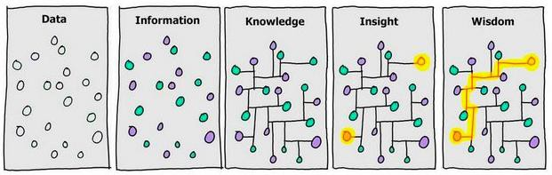
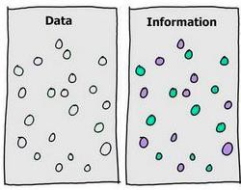

Slide 4
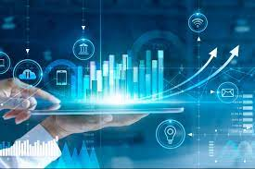

Internal
  Best-in-class organizations excel at strategic use of “Digital”
  Achieving Goals
  Competitive Advantage
  Spawn New Opportunities
External

Slide 5
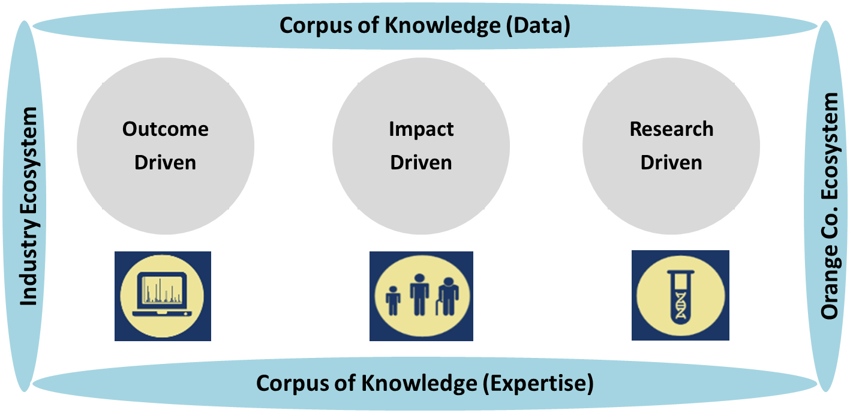
The Collaboratories @ UCI™
i.e., Data as strategy
Research
Excellence
Transformation w/in Living Lab
Individual Empowerment
Strategic Partnerships
Symbiotic Collaboration
With UCI Units
Academic
Partners
Investment
Partners
Data Operating System and Ecosystem
Citizen Science
Industry
Partners
GOVT & Community
Partners

Slide 6
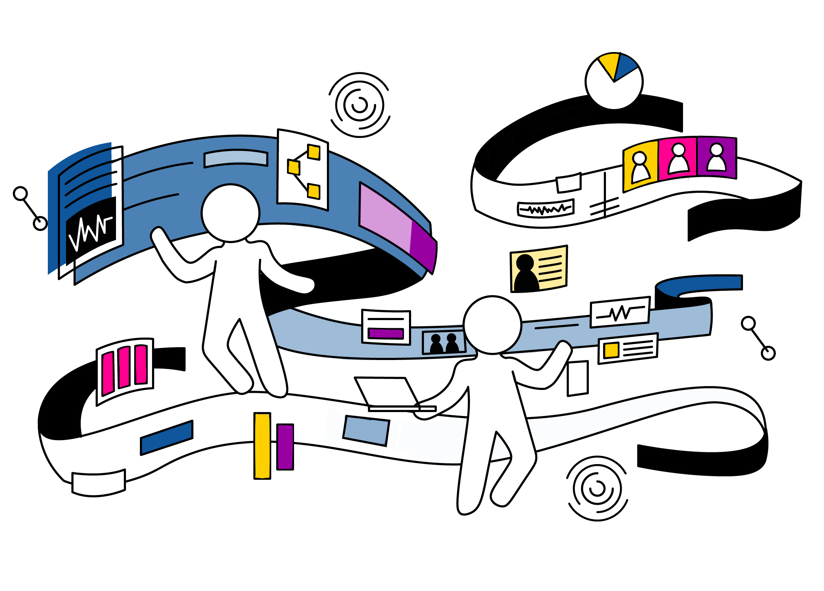
The Collaboratories @ UCI™
i.e., Data as strategy

Slide 7
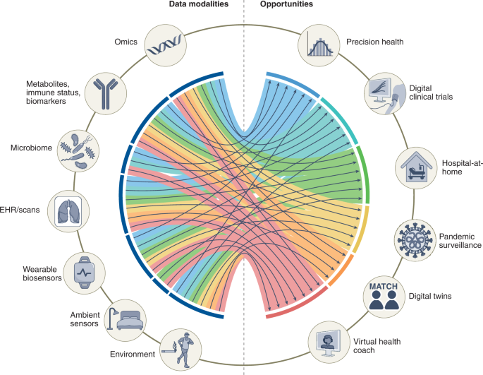
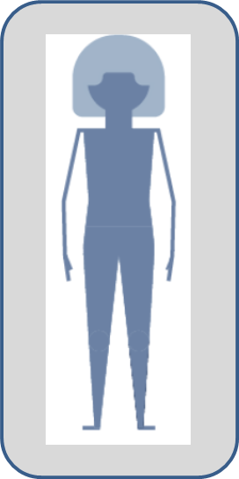
The multi-modal data of human health
Acosta, J.N., Falcone, G.J., Rajpurkar, P. et al. Multimodal biomedical AI. Nat Med (2022). https://doi.org/10.1038/s41591-022-01981-2

Slide 8
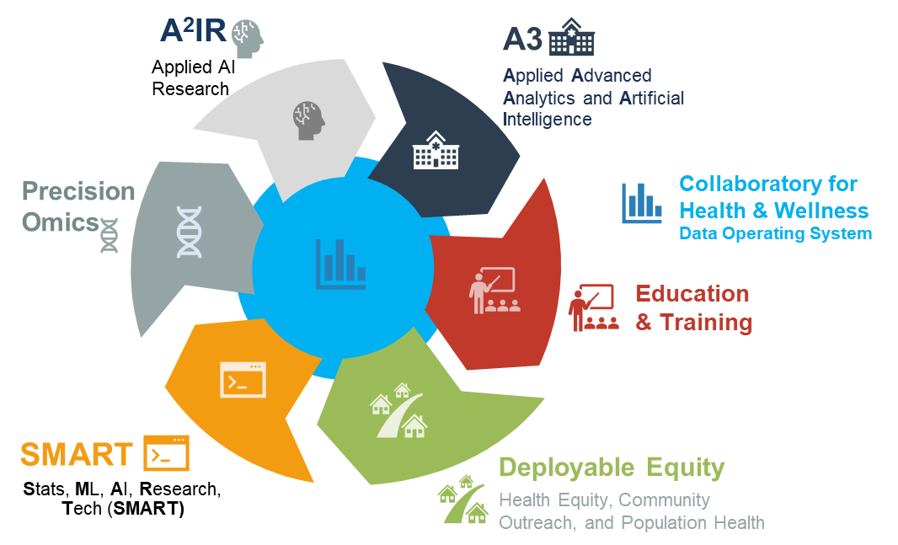
UC Irvine’s institute for precision Health

Slide 9
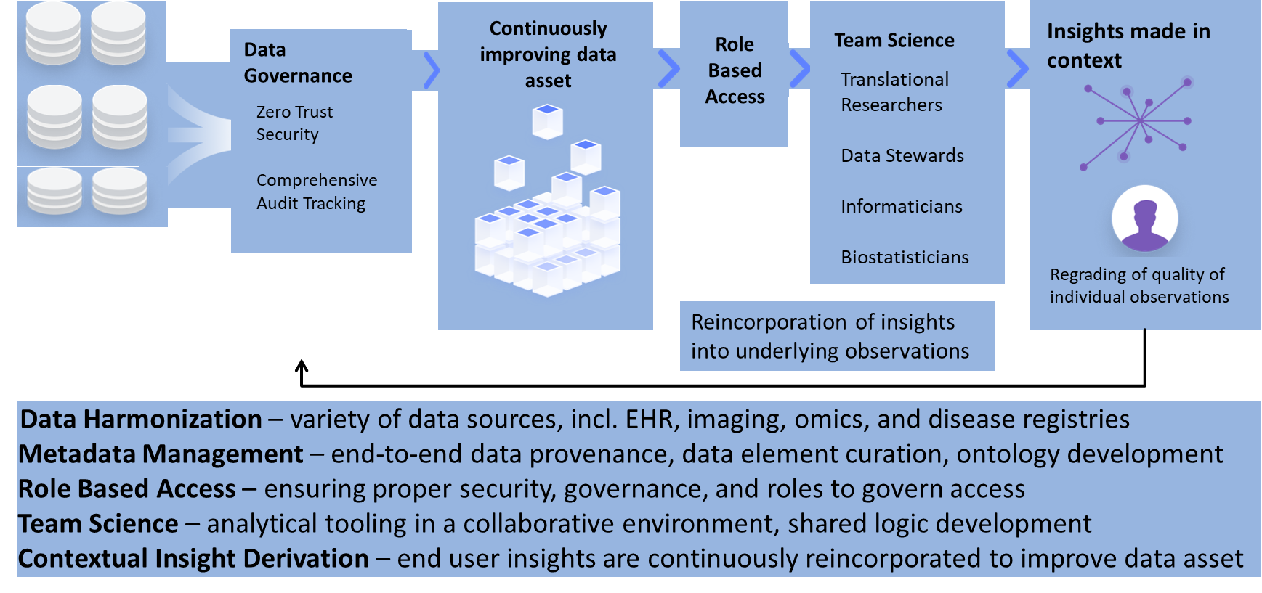
Data Operating System and Ecosystem

Slide 10



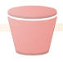

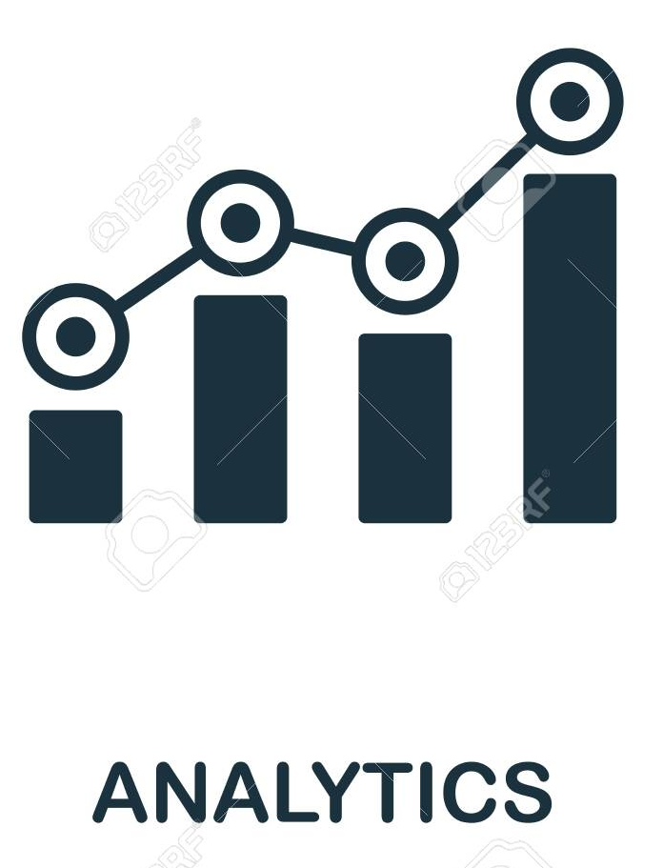




Algorithm Development and Deployment methodology
Curated
Data
Data
Sources
Applied AI Research
Capabilities to support interdisciplinary problem solving
E.g.
COVID Vulnerability
Stroke Risk
Prostate Cancer
Readmissions
New Standard
Of Care
Validation and
Measurement
Deployment
10
The Collaboratories @ UCI ™

Slide 11
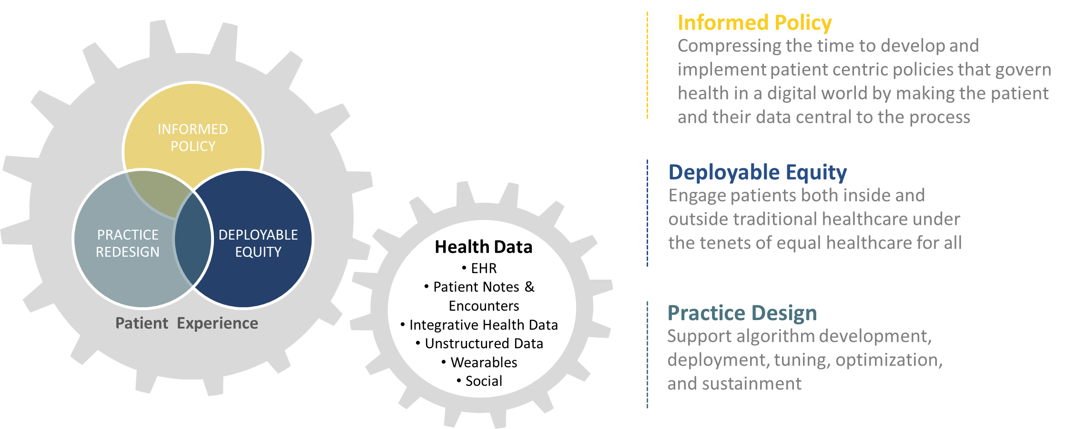
Health Ecosystems through
Public Private Partnerships
Academic
Partners
Industry
government
Community
Partners
Regulators
Patient Advocates

Slide 12
Final thoughts

Slide 13

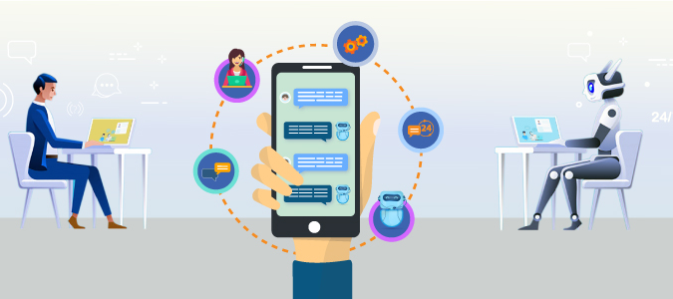
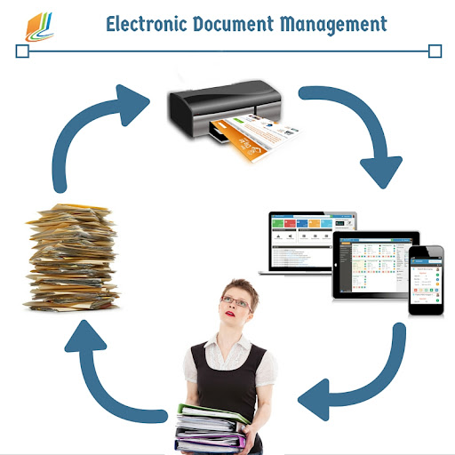


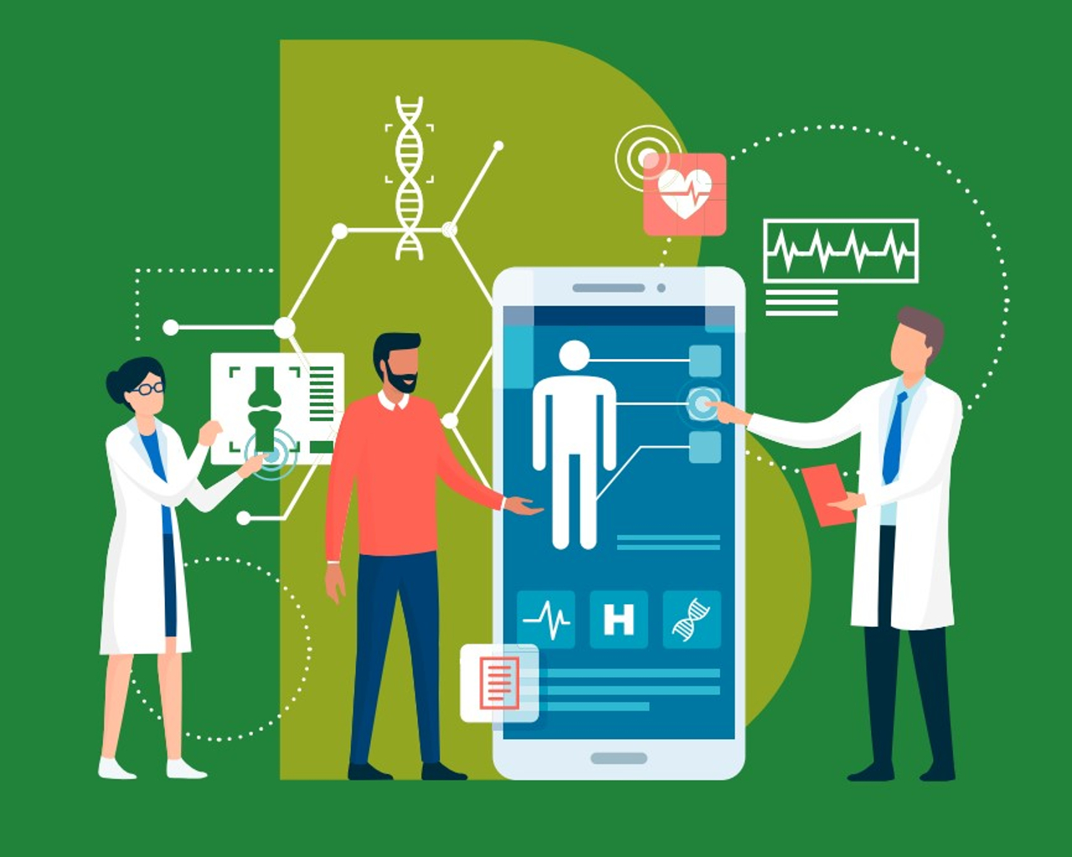
How can we enable & support the future workforce?
How can we elevate & personalize the UCI student experience?
How can we work differently – no paper, automation, extreme personalization?
How can we grow the research enterprise in a more scalable manner?
How can the pedagogy evolve to provide more personalized learning journeys & optionality for students?
How can we care for our patients anywhere and use data to transform the industry?

