Slide 1
Global Trends in Information Governance and Data Protection
An Overview of Privacy Laws in Telehealth

Slide 2
Your Speakers
Charles C. Dunham, IV
Shareholder
Data Privacy & Cybersecurity Group
Greenberg Traurig, LLP
Houston, Texas
+1 713.374.3555 | dunhamc@gtlaw.com
Carsten Kociok
Local Partner
Data Privacy & Cybersecurity Group
Greenberg Traurig Germany, LLP
Berlin, Germany
+49 30 700 171 119 | carsten.kociok@gtlaw.com

Slide 3
Agenda
Privacy Trends
Overview of the General Data Protection Regulation (GDPR)
Overview of the U.S. Federal and State Privacy Laws
Upcoming Trends on Compliance

Slide 4
Privacy Trends

Slide 5
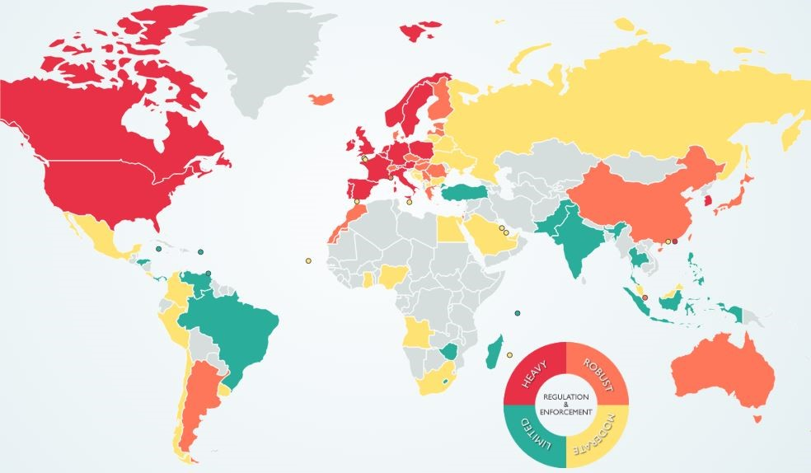
Privacy Trend: Geopolitical Events
Privacy has made it onto the geopolitical world stage.
“Privacy” has become a top political issue in almost every country, but specifically in Europe, China, and the United States.

Slide 6
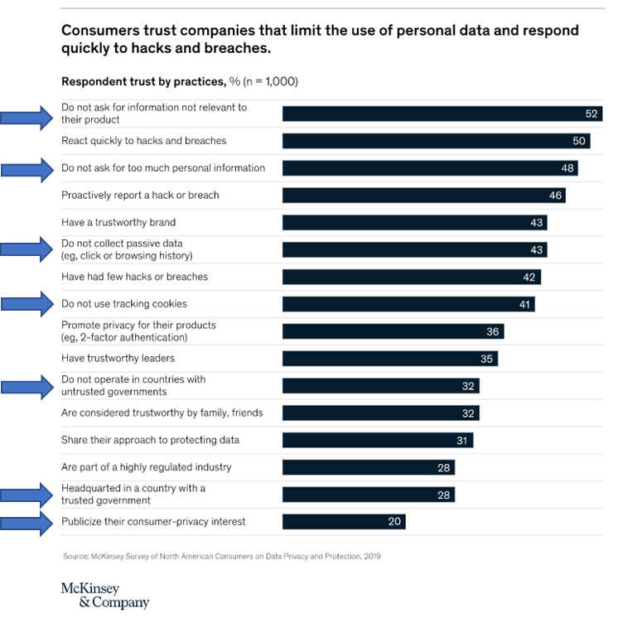
Privacy Trend: Consumer Expectations
Changes in the law, public perception, and media may be leading to changes in consumer expectations.

Slide 7
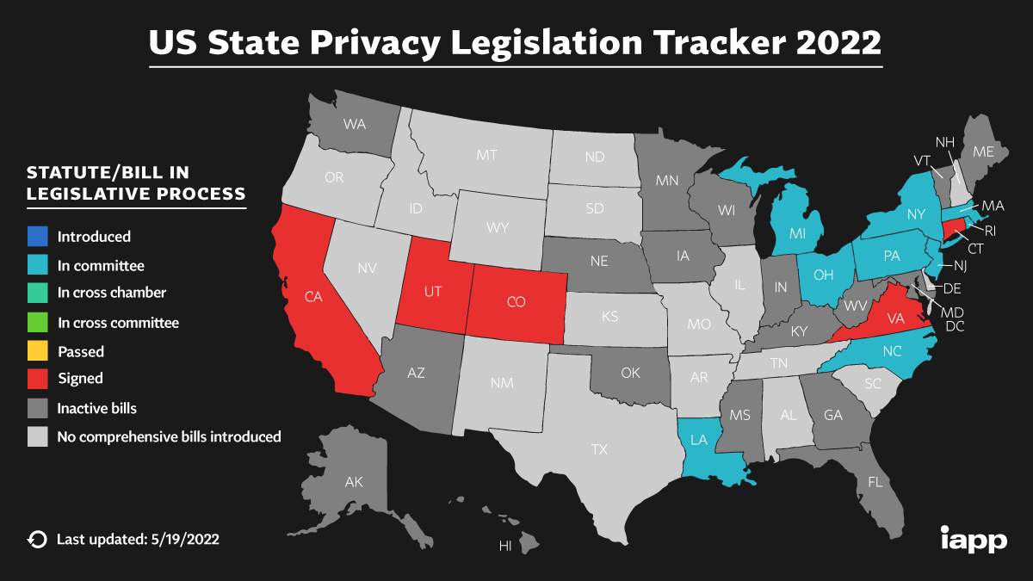
Privacy Trend: Legal Changes
Europe started modern “enhanced” data privacy protections in 2016 with passage of the General Data Privacy Regulation (GDPR).
The United States has been following mostly on the state level, with dozens of statutes being considered.
5 states have moved forward with “comprehensive” privacy legislation: California, Colorado, Connecticut, Utah, and Virginia.
The changes brought by just those five states have been dramatic.

Slide 8
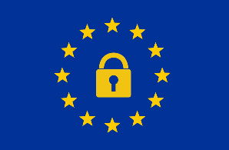
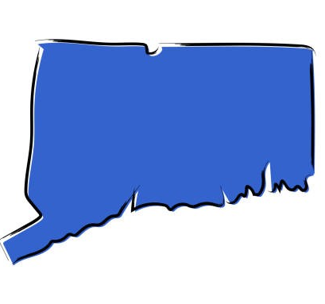
Privacy Trend: Legal Changes
Timeline of Privacy Legislation 2018 - 2023
May 25, 2018
Jan 1, 2020
July 1, 2020
Nov 3, 2020
Jun 28, 2018
Mar 2, 2021
Jul 7, 2021
Mar 24, 2022
Jan 1, 2023
Jul 1, 2023
Dec 31, 2023
May 10, 2022
GDPR becomes effective
CCPA becomes effective
CPRA becomes effective
UCPA becomes effective
CCPA is signed into law
CCPA enforcement begins
CPRA enacted through ballot initiative
VCDPA is signed into law
CPA
is signed into law
UCPA
is signed into law
CTDPA
is signed into law
CPRA enforcement begins
CPA becomes effective
VCDPA
becomes effective
CTDPA becomes effective
GDPR = General Data Protection Regulation
CCPA = California Consumer Privacy Act
CPRA = California Privacy Rights Act
CPA = Colorado Privacy Act
CTDPA = Connecticut Data Privacy Act
VCDPA = Virginia Consumer Data Protection Act
UCPA = Utah Consumer Privacy Act

Slide 9
Overview of the General Data Protection Regulation

Slide 10
Overview of the GDPR – Executive Summary
What is it?
The General Data Protection Regulation (GDPR) codifies and unifies data privacy laws across all member countries of the European Economic Area (EEA).
When did it go into effect?
The GDPR was enacted in 2016 and became enforceable on May 25, 2018.
Why does it matter?
Penalties for non-compliance with the provisions of the GDPR regarding collecting and using personal data are potentially devastating -- €20 million or 4% of global revenue (whichever is higher), plus data subjects have the right to seek compensation for damages.
Who does it affect?
The GDPR applies to:
Entities that have an establishment in the EEA
Non-EEA entities that (1) offer goods or services to individuals in the EEA or (2) monitor behavior.

Slide 11
Overview of the GDPR – Key Definitions
Personal Data | Any information relating to an identified or identifiable natural person (or “Data subject”). An identifiable natural person is one who can be identified, directly or indirectly, in particular by reference to an identifier such as a name, an identification number, location data, an online identifier or to one or more factors specific to the physical, physiological, genetic, mental, economic, cultural or social identity of that natural person.
Controller | A natural or legal person…which, alone or jointly with others, determines the purposes and means of the processing of personal data.
Processor | A natural or legal person…which processes personal data on behalf of the controller.
Processing | Any operation or set of operations which is performed on personal data or on sets of personal data, whether or not by automated means, such as collection, recording, organization, structuring, storage, adaptation or alteration, retrieval, consultation, use, disclosure by transmission, dissemination or otherwise making available, alignment or combination, restriction, erasure or destruction.

Slide 12
Overview of GDPR – what does it require
 |  | GDPR
Legal Basis | Justification (Consent, Contract, Legitimate Purpose etc.) | ✓
 | Data Minimization | ✓
Individual Rights | Notices to Data Subjects | ✓
 | Financial Incentive Disclosure
 | Right to Access Data | ✓
 | Right to Fix Errors (aka Right to Correction/Rectification) | ✓
 | Right to Deletion (aka Right to Be Forgotten) | ✓
 | Right to Opt Out of Sale | ✓*
 | Right to Opt Out of Behavioral Advertising | ✓*
 | Right to Object to Use of Sensitive Information | ✓*
 | Right to Object to Automated Decision Making & Profiling | ✓
 | Right to Object to Other Uses | ✓
 | Right to Nondiscrimination
Accountability & Governance | Documentation & Recordkeeping | ✓
 | Risk Assessments | ✓
 | Designate a DPO (if necessary) | ✓
Security | Appropriate Data Security to Safeguard Information | ✓
 | Breach Notification | ✓
Data Transfers Outside of EEA | Adequacy measures req’d for countries w/ laws that don’t parallel EEA | ✓
Transfers to Third Parties | Contractual Requirements in Service Provider Agreements | ✓
 | Joint controllers should allocate responsibilities. | ✓
Marketing & AdTech | Consent for AdTech Cookies | ✓
 | Consent obtained prior to direct marketing | ✓

Slide 13
Overview of the GDPR – sharing health data
Special categories of personal data
Data revealing racial or ethnic origin, political opinions, religious or philosophical beliefs, or trade union membership, genetic data, biometric data for the purpose of uniquely identifying a natural person, data concerning health, sex life or sexual orientation
Sharing or processing requires specific justification
Consent
Processing necessary for the purposes of preventive or occupational medicine
Processing necessary for reasons of public interest in the area of public health
Data transfer to “non-adequate third countries”
Standard Contractual Clauses (SCC)
New set of SCC from 4 June 2021
Transfer impact assessment required

Slide 14
U.S. Federal Privacy Protection Laws

Slide 15
HIPAA and HITECH
Individual Rights to PHI
Administrative, Physical and Technical Safeguards
Electronic Protected Health Information (ePHI)
Security Management and Incident Process
Breach Mitigation and Notification

Slide 16
Information Blocking
April 5, 2021 (effective date): Disclosure of privacy policies and compliance
October 6, 2022 – Required to share full scope of EHI
“EHI” - Cross-reference to ePHI under HIPAA (a “designated record set”)
“Actors” - Healthcare providers(*), health IT developers of certified health IT, and HIEs/HINs
Any interference outside (8) exceptions will be “inherently suspect”
The term exempts any practices “required by law” [45 CFR 171.103(a)(1)]
The term exempts certain fees [45 CFR 171.302(a)(2)(vi)]
The term exempts prevention of harm [45 CFR 171.201]
The term exempts security measures [45 CFR 171.203]
The term exempts licensing protections [45 CFR 171.303(b)(2)(iv)]

Slide 17
American Data Privacy and Protection Act
Introduced in House (06/21/2022) (H.R. 8152)
Limit the collection, processing, and transfer of personal data without affirmative express consent.
Right to access, correct, and delete personal data; Opt-out advertising.
Additional protections to personal data of minors (under 17).
Security practices to protect and secure personal data.
The bill preempts state laws except for certain categories of state laws.

Slide 18
U.S. State Privacy Protection Laws

Slide 19
Overview of the CPRA – Executive Summary
What is it?
The California Privacy Rights Act (CPRA) amends and expands the California Consumer Privacy Act (CCPA)
When does it go into effect?
The CPRA will become effective January 1, 2023
Why does it matter?
The CPRA creates new rights and imposes additional obligations on businesses:
Right to correction
Right to data portability
Right to opt-out of cross-context behavioral advertising
Right to access information about automated decision making
Right to limit the use of Sensitive Personal Information
It also borrows from the GDPR by introducing new principles:
Data Minimization
Purpose Limitation
Storage Limitation

Slide 20
CPRA at a Glance
Effective Date: January 1, 2023 The CPRA amends and expands the California Consumer Privacy Act (“CCPA”) and creates new rights and imposes additional obligations on businesses. What information is covered? Sensitive Personal Information (Sensitive PI) – the CPRA includes a new category of “sensitive personal information.”
Account log-in with password* Audio, electronic, visual, thermal, olfactory, or similar information Bank account number* Biometric information – fingerprint, face/iris/voice recognition, DNA* Commercial information (e.g., products or services purchased, or other purchasing or consuming histories or tendencies Contents of mail / email / texts* Credit or debit card information* Driver’s license number / State ID* Education, employment & employment history Email address Health insurance information* Identifiers (e.g., name or alias) Insurance policy number Medical or health information (e.g., genetic data, etc.)* | Network activity (e.g., browsing and interaction history) Other financial information* Passport number* Physical characteristics Postal address Precise geolocation data* Protected classifications (e.g., age, gender, racial or ethnic origin, religious or philosophical beliefs, union membership, physical or mental handicap, etc.)* Sex life or sexual orientation* Signature Social Security Number* Telephone Number Inferences drawn to create a profile (e.g., preferences; characteristics; psychological trends; predispositions; behavior; attitudes; intelligence; abilities; or aptitudes.
What are business’ main obligations ?
Purpose limitation. Businesses must not collect or use PI for a new purpose that is incompatible with previously disclosed purposes without first providing consumer notice.
Retention Periods. A business can only retain PI for as long as is “reasonably necessary and proportionate” to achieve the purpose disclosed to consumers. A business is required to disclose the length of time that it intends to retain each category of PI or explain the criteria that is uses to set its retention periods.
New Contracting Requirements. Requires businesses to enter into contracts extending the CPRA requirements to these entities’ handling of such PI and requires service providers to have similar contracts in place with any sub-service providers.
Security Audits. Businesses are required to perform a “cybersecurity audit” annually if the use of PI presents a “significant risk to consumers’ privacy or security.”
Privacy Risk Assessments. Requires businesses to submit a risk assessment “on a regular basis” to the California Privacy Protection Agency.

Slide 21
CPRA at a Glance (cont’d)
What rights does the CPRA afford California residents?
Right to Access. Consumers may request access to their PI.
Right to Correction. Consumers may request any correction of their PI held by a business if that information is inaccurate.
Right to Delete. Consumers may request deletion of their PI.
Right to Opt Out of Sale. Consumers may opt out of the sale of their PI to third parties (including sensitive PI).
Right to Opt Out of Behavioral Advertising. Consumers may opt out of the sharing of their PI with cross-context behavioral advertising companies.
Opt-In Rights for Minors. Businesses cannot share or sell PI of consumers under 16 without express authorization. As with the opt-out right, businesses must wait 12 months before asking a minor for consent to sell or share his or her PI after the minor has declined to provide it.
Right to Opt Out of Use of Sensitive PI. Consumers may limit the use and disclosure of sensitive PI for certain “secondary” purposes, including prohibiting businesses from disclosing sensitive PI to third parties, subject to certain exemptions.
Right to Opt Out of Automated Decision-Making Technology. Consumers may opt out of automated decision-making technology, including “profiling,” in connection with decisions related to a consumer’s work performance, economic situation, health, personal preferences, interests, reliability, behavior, location or movements.
Right to Nondiscrimination. Businesses may not discriminate against consumers exercise of their data rights (i.e., denying access to, charging different prices for, or providing different qualities of goods or services.)
❗ Modified
❗ Modified
❗ Modified

Slide 22
New State Privacy Laws
(4) U.S. States have followed California’s lead by enacting comprehensive privacy laws.
Virginia Consumer
Data Protection Act (VCDPA)
Colorado Privacy Act (CPA)
Utah Consumer Protection Act (UCPA)
Connecticut Data Privacy Act

Slide 23
New State Privacy Laws: CPA
Key Takeaways:
The CPA requires controllers to:
Conduct data protection assessments for certain activities
Obtain consent for the processing of sensitive personal information
Establish an appeals procedures for denial of consumer requests.
Definition of “sale” aligns with the CPRA (i.e., is defined as “the exchange of personal data for monetary or other valuable consideration by the controller to a third party” with specific exclusions).

Slide 24
New State Privacy Laws: CTDPA
Key Takeaways:
Like the CPA, the CTDPA requires controllers to:
Conduct data protection assessments for certain activities
Obtain consent for the processing of sensitive personal information
Establish an appeals procedures for denial of consumer requests.
The rights provided to Connecticut consumers are the same as those under the CPA.
The differences between Connecticut and Colorado are relatively subtle.

Slide 25
New State Privacy Laws: UCPA
Key Differences:
Unlike the CPRA, CPA, CTDPA, (and the VCDPA) the UCPA does not require controllers to conduct and document data protection impact assessments.
The UCPA takes a more limited approach to requirements in contracts between controllers and processors.
Unlike Colorado and Connecticut requirement to obtain consent prior to processing sensitive data, the UCPA requires controllers to “present consumers with clear notice and opportunity to opt out of the processing of sensitive data.”
The UCPA does not obligate controllers to:
Correct personal data;
Allow for opt-out of profiling; or
Provide an appeals process.

Slide 26
New State Privacy Laws: VCDPA
Key Takeaways:
Scope of the VCDPA is slightly more limited than CCPA/CPRA
The VCDPA does not apply to employees or business contacts
The VCDPA contains expanded individual rights
Controllers must obtain consent to processing sensitive personal data
Data protection assessments are required for certain processing activities
There is no private right of action

Slide 27
New UK DPDI Bill
UK Data Protection and Digital Information Bill (from 18 July 2022)
Intends to update and simplify UK’s data protection framework to reduce burdens on organisations and ensure high data protection standards
Subjective definition of “personal data”
Removes certain accountability requirements such as DPO, UK representative or Data Protection Impact Assessments
Risk-based assessment of impact of international data transfers
Organisations may refuse to respond to data subject access requests which are “vexatious or excessive”, or charge a respective fee

Slide 28
Side-by-Side Comparison: European & US Data Privacy Laws
 |  | GDPR | CCPA | CPRA | CPA | CTDPA | UCPA | VCDPA
Ability to Process Data | Permissible Purpose | ✓ |  | ✓ | ✓ | ✓ |  | ✓
 | Data Minimization | ✓ |  | ✓ | ✓ | ✓ |  | ✓
Individual Rights | Notices to Data Subjects | ✓ | ✓ | ✓ | ✓ | ✓ | ✓ | ✓
 | Financial Incentive Disclosure |  | ✓ | ✓
 | Right to Access Data | ✓ | ✓ | ✓ | ✓ | ✓ | ✓ | ✓
 | Right to Fix Errors (aka Right to Correction/Rectification) | ✓ |  | ✓ | ✓ | ✓ |  | ✓
 | Right to Deletion (aka Right to Be Forgotten) | ✓ | ✓ | ✓ | ✓ | ✓ | ✓ | ✓
 | Right to Opt Out of Sale | ✓* | ✓ | ✓ | ✓ | ✓ | ✓ | ✓
 | Right to Opt Out of Behavioral Advertising | ✓* |  | ✓ | ✓ | ✓ | ✓ | ✓
 | Right to Object to Use of Sensitive Information | ✓* |  | ✓ |  | ✓*
 | Right to Object to Automated Decision Making & Profiling | ✓ |  | ✓ | ✓ | ✓ |  | ✓
 | Right to Object to Other Uses | ✓
 | Right to Nondiscrimination |  | ✓ | ✓ | ✓ | ✓ | ✓ | ✓
Accountability & Governance | Documentation and Recordkeeping | ✓ |  | ✓ | ✓ | ✓ | ✓ | ✓
 | Risk Assessments | ✓ |  | ✓ | ✓ | ✓ |  | ✓
 | Designate a DPO (if necessary) | ✓
Security | Appropriate Data Security to Safeguard Information | ✓ | ✓* | ✓ | ✓ | ✓ | ✓ | ✓
 | Breach Notification | ✓ | ✓* | ✓* | ✓* | ✓* | ✓* | ✓*
Data Transfers Outside of EEA | Adequacy measures required for any country determined to have laws that do not parallel EEA | ✓
Transfers to Third Parties | Contractual Requirements in Service Provider Agreements | ✓ |  | ✓ | ✓ | ✓ | ✓ | ✓
 | Joint controllers should allocate responsibilities. | ✓ |  | ✓
Marketing & AdTech | Consent for AdTech Cookies | ✓
 | Consent obtained prior to direct marketing | ✓

Slide 29
Case Study

Slide 30
Decentralized Clinical Trial
Sites located in U.S. and EU
Subjects located in U.S. and EU
Lab Testing performed in U.S.
Health IT vendor with servers located in U.S.
GDPR Compliance (SCCs)
Is HIPAA triggered?
FDA and Common Rules
State Privacy Laws triggered?

Slide 31
Q & A

Slide 32
Appendix

Slide 33
Overview of the GDPR
7 Key Data Protection Principles
Lawfulness, fairness, and transparency
Purpose Limitation
Data Minimization
Integrity & Confidentiality
Storage Limitation
Accuracy
Accountability
Practical Impact
Personal Data
Ability to Process Data
Individual Rights
Record Keeping
Data Security
Cross-Border Data Transfers
Sharing Data

Slide 34
Overview of the GDPR
Personal Data
Ability to Process Data
Individual Rights
Record Keeping
Data Security
Cross-Border Data Transfers
Sharing Data
The GDPR requires any organization processing personal data to have a valid legal basis for that personal data processing activity. GDPR provides six legal bases for processing:
Consent
Performance of Contract
Legitimate Interest
Vital Interest
Legal Requirement
Public Interest
Ability to Process Data

Slide 35
Overview of the GDPR
Personal Data
Ability to Process Data
Individual Rights
Record Keeping
Data Security
Cross-Border Data Transfers
Sharing Data
The GDPR gives certain rights to data subjects, including:
Right to be informed (e.g., Privacy Notices)
Right to access
Right to rectification
Right to erasure
Right to restriction
Right to data portability
Right to object
Right in relation to automated decision-making
Individual Rights

Slide 36
Overview of the GDPR
Personal Data
Ability to Process Data
Individual Rights
Record Keeping
Data Security
Cross-Border Data Transfers
Sharing Data
The GDPR requires organizations to keep records of processing activities (i.e., data inventory and data mapping)
The GDPR also requires a Data Protection Impact Assessment (DPIA) any time there is data processing that is likely to be “high risk”.
Record
Keeping

Slide 37
Overview of the GDPR
Personal Data
Ability to Process Data
Individual Rights
Record Keeping
Data Security
Cross-Border Data Transfers
Sharing Data
GDPR requires all data controllers and data processors that handle personal data to apply appropriate security and organizational measures in order to safeguard the confidentiality, integrity, and availability of processing services.
Organizations are required to report some types of data breaches.
Data Security

Slide 38
Overview of the GDPR
Personal Data
Ability to Process Data
Individual Rights
Record Keeping
Data Security
Cross-Border Data Transfers
Sharing Data
The GDPR prohibits sending personal data outside of the EU unless specific conditions re met or steps are taken in connection with the data (e.g., specific types of contracts are executed, internal policies exist to protect the data, etc.).
Cross-Border Data Transfers

Slide 39
Overview of the GDPR
Personal Data
Ability to Process Data
Individual Rights
Record Keeping
Data Security
Cross-Border Data Transfers
Sharing Data
There must be a contract between a controller and processor to govern the processing. It must set forth:
Controller’s instructions,
Details of Processing (e.g., nature, purpose, duration, etc.
Duties of confidentiality
Deletion or return of all personal data
Audit rights of the controller
Flow-down of obligations to subprocessors
Sharing Data

