Slide 1
Physicians, technology, and the bottom line
Dr. Adam M. Robison MD

Slide 2
Introduction
Physician
Medical Director for Hospital Medicine
Founder; Chief Medical Officer
Dr Adam Robison, MD
4 hospitals
3 periop clinics
Tech startup
Clinical
Hospital leadership
Technology

Slide 3
How to align physicians and hospitals?
NOT taught in medical school
Taught in Medical School
Quality Metrics
Diagnose
Coding queries
Treat
CMS regulations
Hospitals care
Physicians care less
Hospitals care
Physicians care

Slide 4
The secret about physicians
Health systems are dependent on physicians to drive key hospital metrics
But physicians are only trained in two things:
Diagnosis
Treatment
We are not trained in:
population health
Coding
Insurance nuances
CMS regulations
Core metrics
... And many more

Slide 5
Misaligned!
Admin
Clinic
Misaligned!

Slide 6
Outcomes that require alignment
Readmissions
Length of stay in the hospital
Decreased morbidity
Decreased mortality
Decreased cost of care
Accurate disease burden description (i.e. RAMI)
?????

Slide 7
Why is this so difficult?
Stakeholders ultimately care about the same thing; why is attaining alignment so difficult?
Hospitals and physicians often work against each other in their efforts to provide better care

Slide 8
Knowledge gaps
There are several knowledge gaps that will continue to have us rowing in different directions:
Physician’s clinical knowledge and clerical knowledge (i.e documentation)
Patient’s ability to navigate complicated disease processes
Health system’s lack of useful data to move the needle on important metrics
Understanding gap between all three parties

Slide 9
Do current tools in the space address these gaps?
Ai (IBM Watson)
Scoring tool for risk of admission
What do we do with this information
Non-actionable information
Incorrect information
Non-timely information (i.e. too late to be useful)
EHR and sepsis BPA (patient was already septic and being treated appropriately

Slide 10
We must achieve alignment to address the gaps
Improved patient care

Slide 11
How?

Slide 12
EHRs are filled with the answer
The answer to the universe, life, and everything? 42.
Current tools give us 42, we are not asking the right questions.

Slide 13
Data and Interoperability
SMART on FHIR allows us to take data out of the EHR and ask the right questions.
Few are doing this well
We can now do interesting things such as:
Integrated evidence-based suggestions that are tied directly to the workflow of the clinician
Automate and standardize clinical documentation processes that support regulations hospitals must comply with
Aggregate population level statistics on evidence based medicine initiatives
Passive education and training at the point of care

Slide 14
Technology is healthcare’s drive train

Slide 15
Aligned!
Admin
Clinic
Aligned!

Slide 16
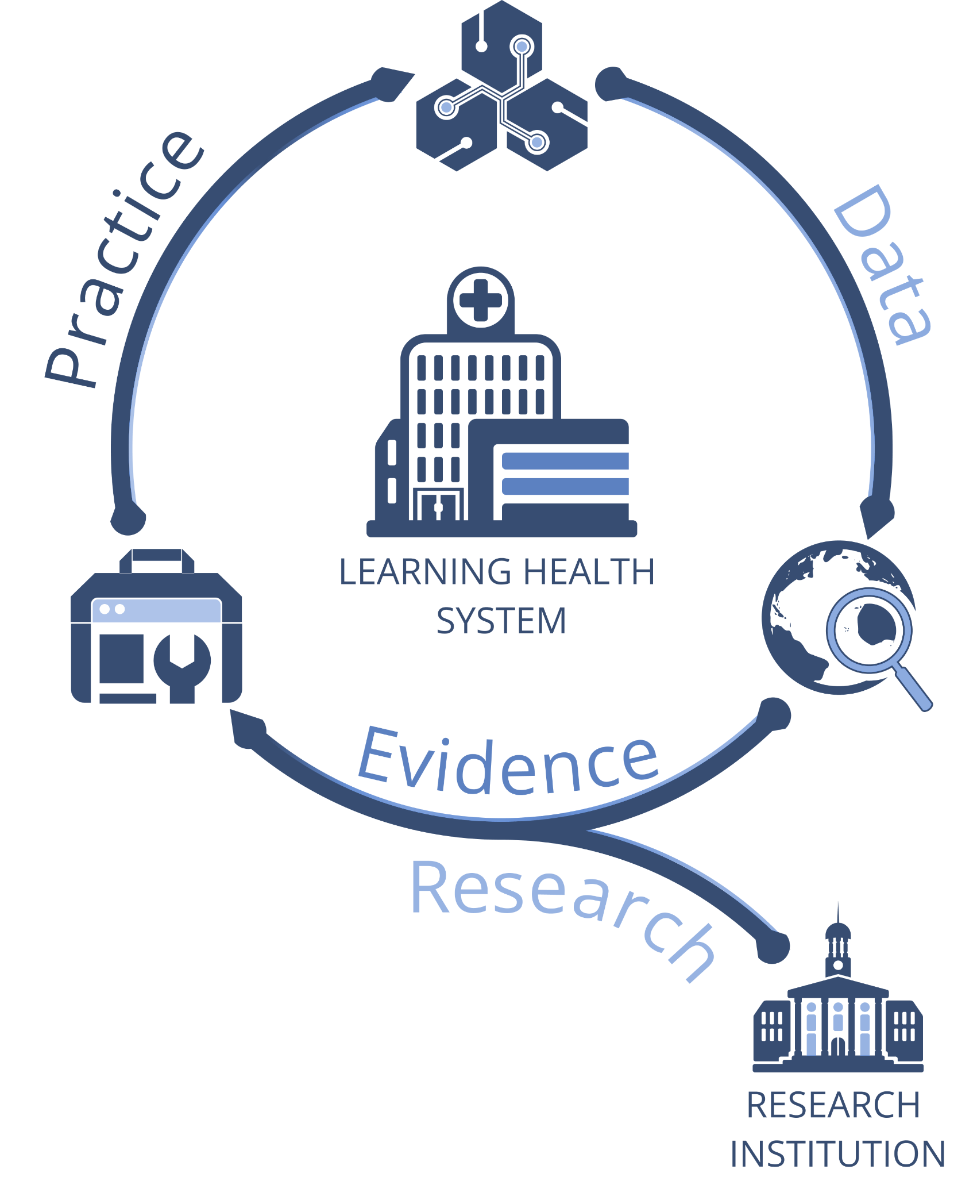
Learning health system
Readmissions
Length of stay in the hospital
Decreased morbidity
Decreased mortality
Decreased cost of care
Accurate disease burden description (i.e. RAMI)
?????

Slide 17
Questions?

